Slide 1
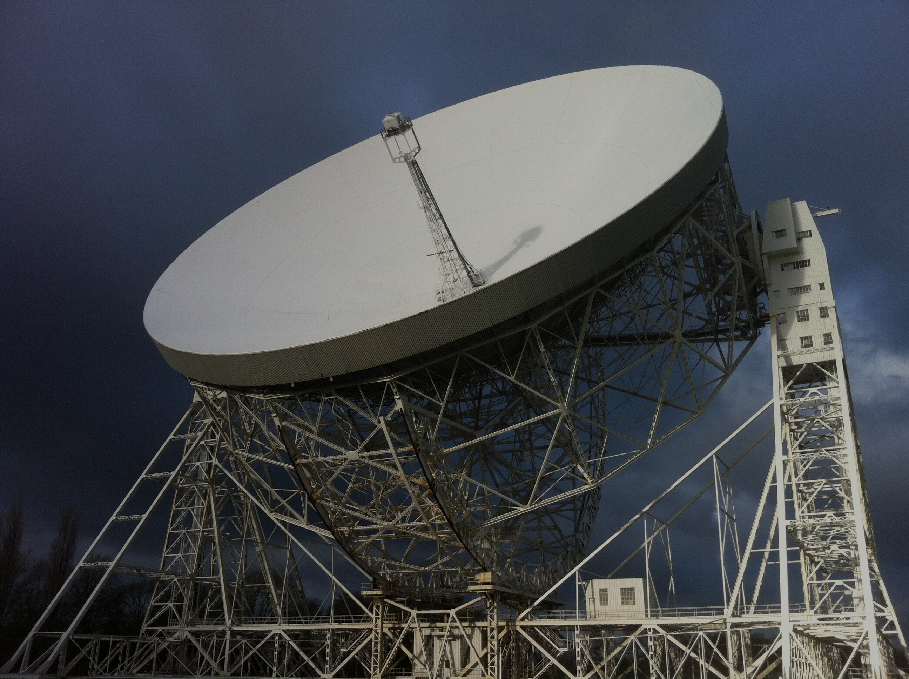


A.I. for Astrophysics: Masterclass
Dr. Rob Lyon
Edge Hill University
robert.lyon@edgehill.ac.uk
@scienceguyrob

Slide 2
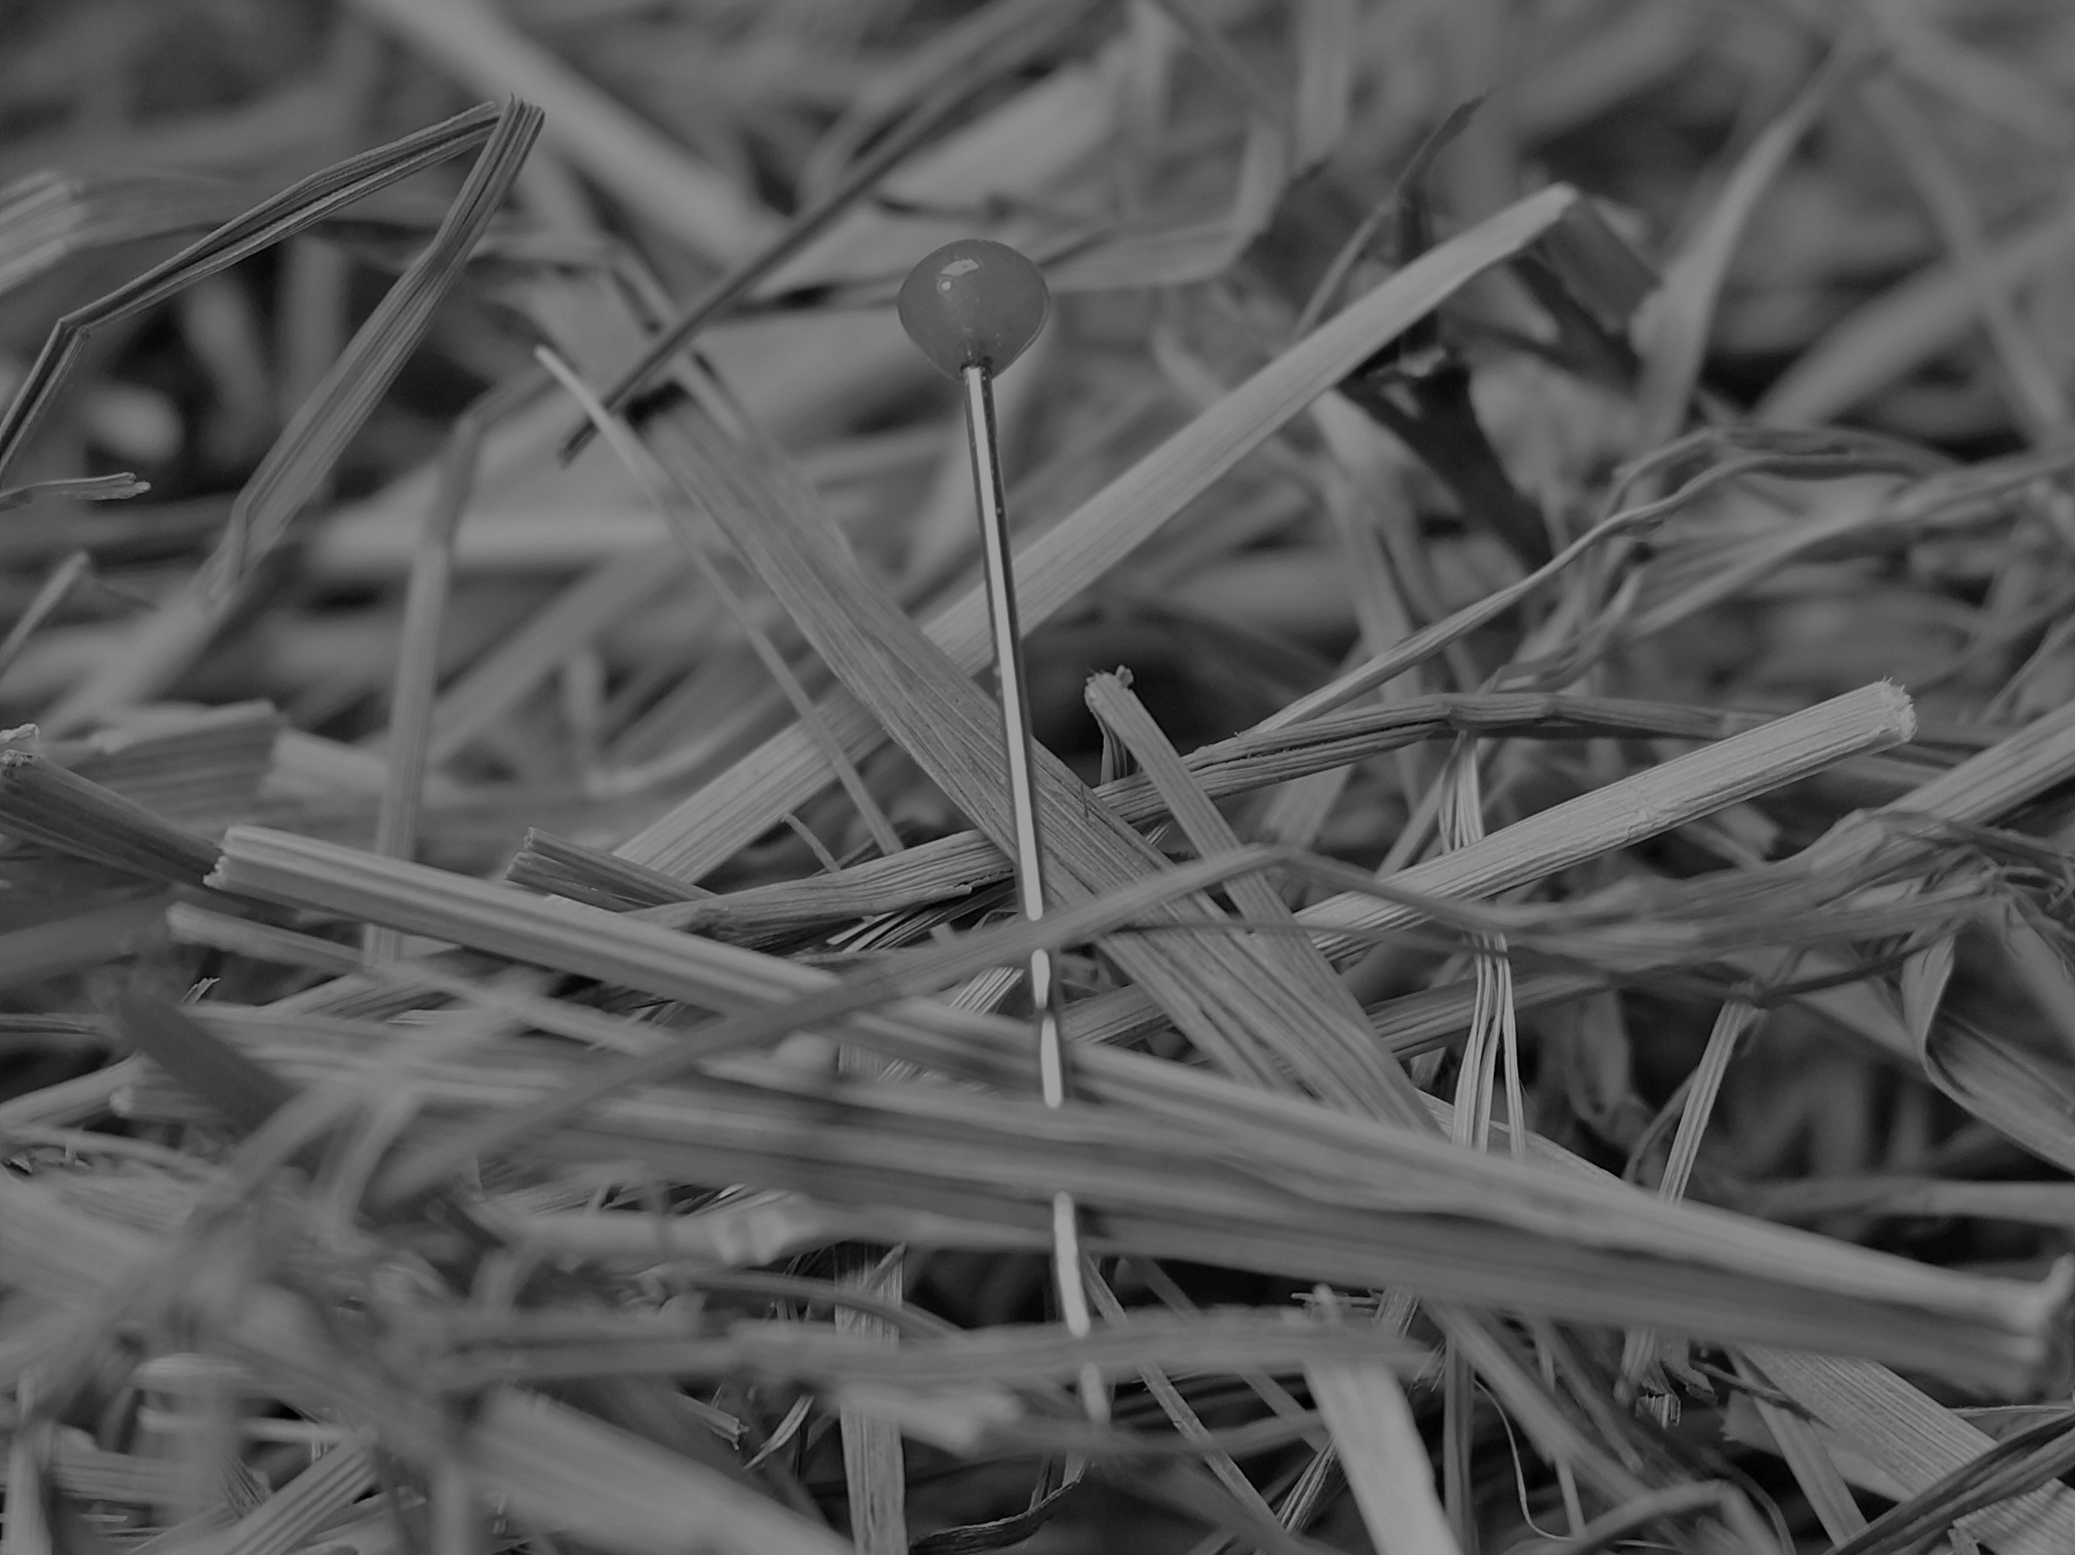
Welcome
In the next few hours we’ll learn how to apply ML to a real-world astrophysics problem. If you’ve never done machine learning before don’t worry. I’ll cover everything you need to know including:
Machine learning basics.
Python basics.
The astronomy background you’ll need to understand the challenge.
If you have questions at any point – just ask. We’ll move through things slowly. We want this masterclass to be enjoyable!

Slide 3

Masterclass Environment

Slide 4


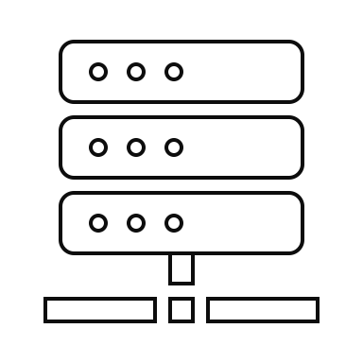

Google Colab
A cloud environment containing the tools need to write & execute Python programs.
You’ll need is a google account to use, e.g. a Gmail Account and the Chrome Web Browser.
When you login to the Collaboratory, it creates a computer just for you.
Inside you can create & execute Python code.
Before proceeding, please create a Google account if you don’t already have one.
Language Tools
External Libraries
Tools (Code Editors etc.)

Slide 5
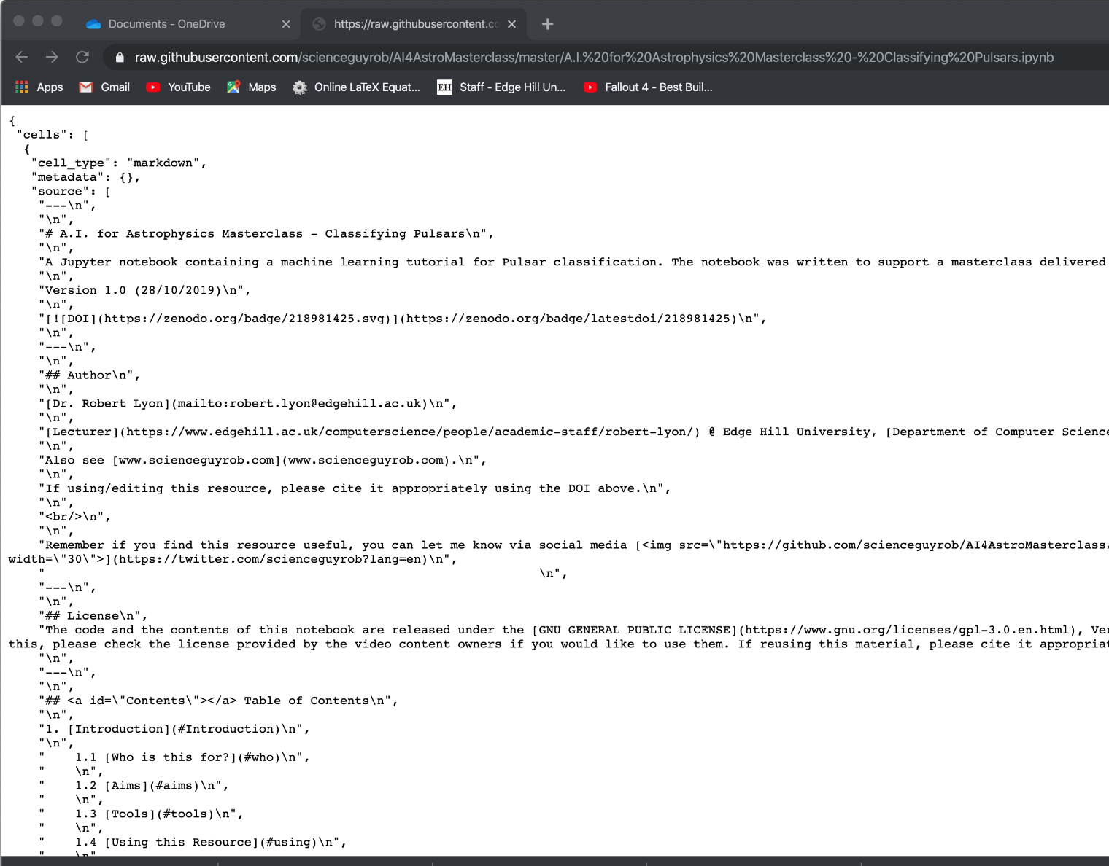
Accessing the Masterclass Resource
Open Google Chrome.
Navigate to: https://github.com/scienceguyrob/AI4AstroMasterclass
Click the file: “A.I. for Astrophysics Masterclass - Classifying Pulsars.ipynb”
There is a button with the text “Raw” on it – click it. This will load the resource into your browser.
Save the content to your own machine – left click and choose the “Save as” option that appears on the popup menu. Keep the .ipynb file extension.
Open Google Colab: https://colab.research.google.com/
Click the File menu, click “Upload Notebook”. Choose the file you saved on your machine.

Slide 6
Astrophysics Background

Slide 7

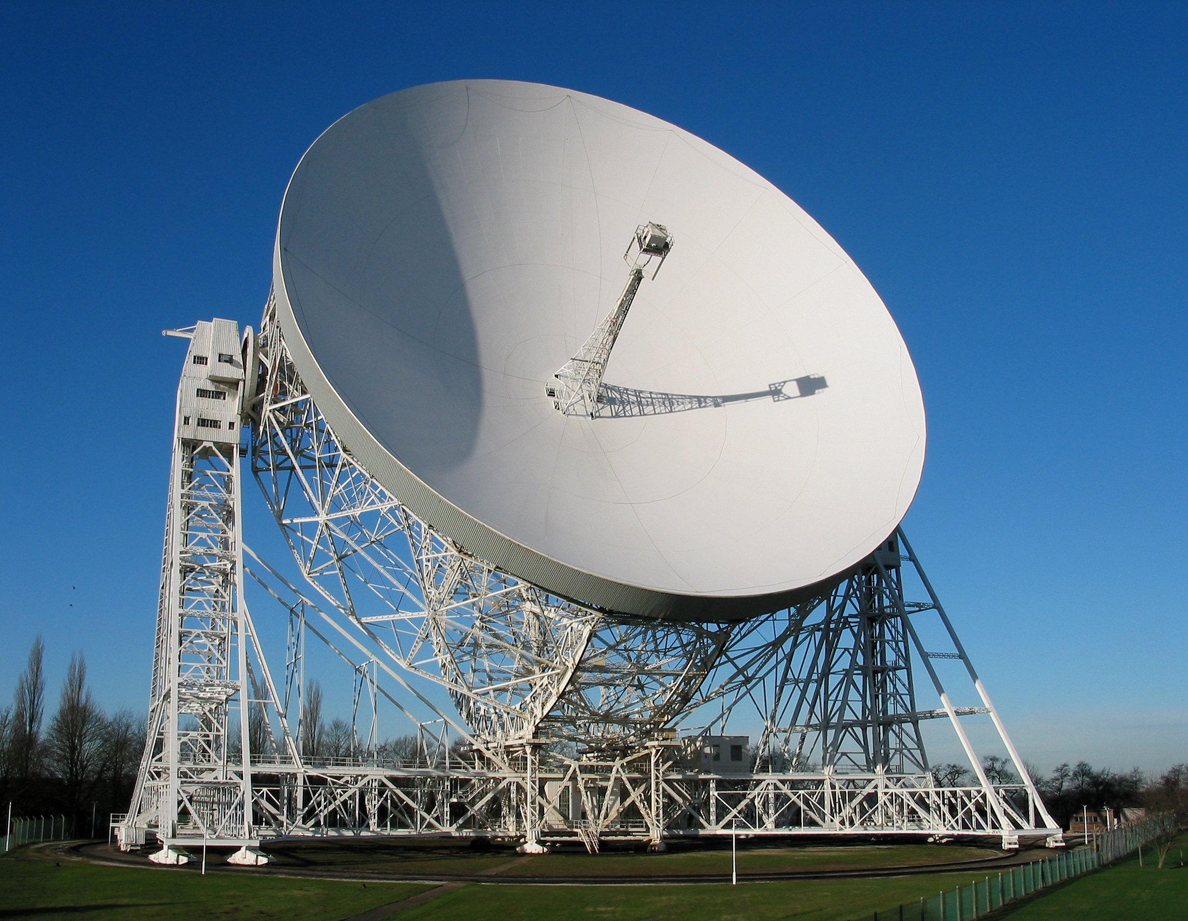
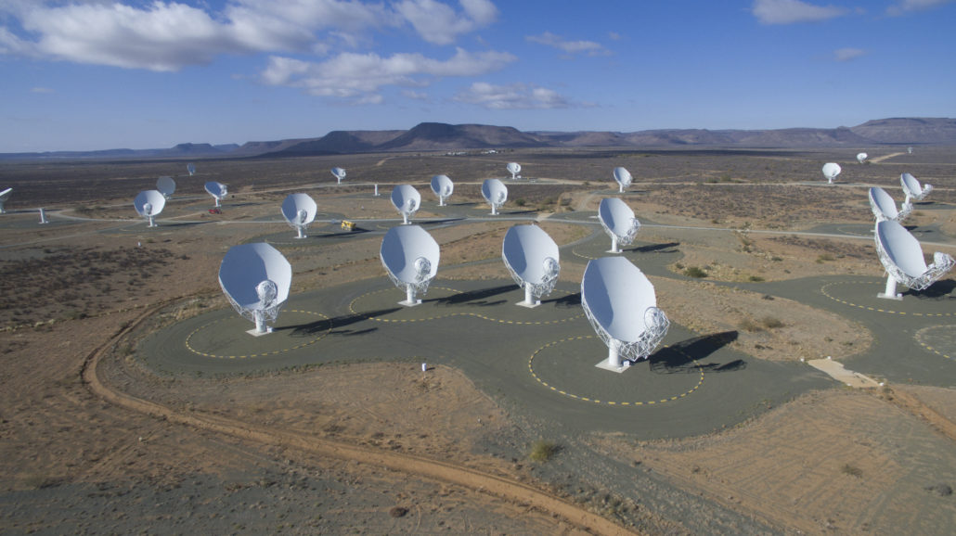

Slide 8
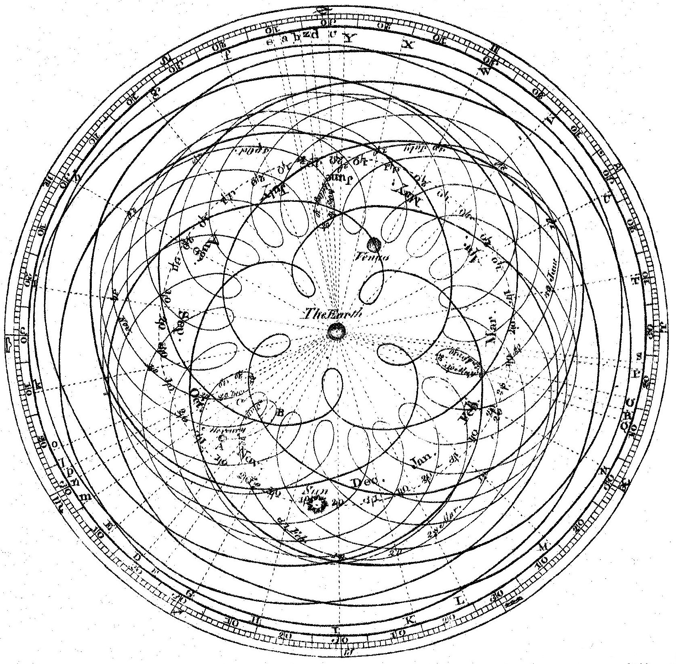
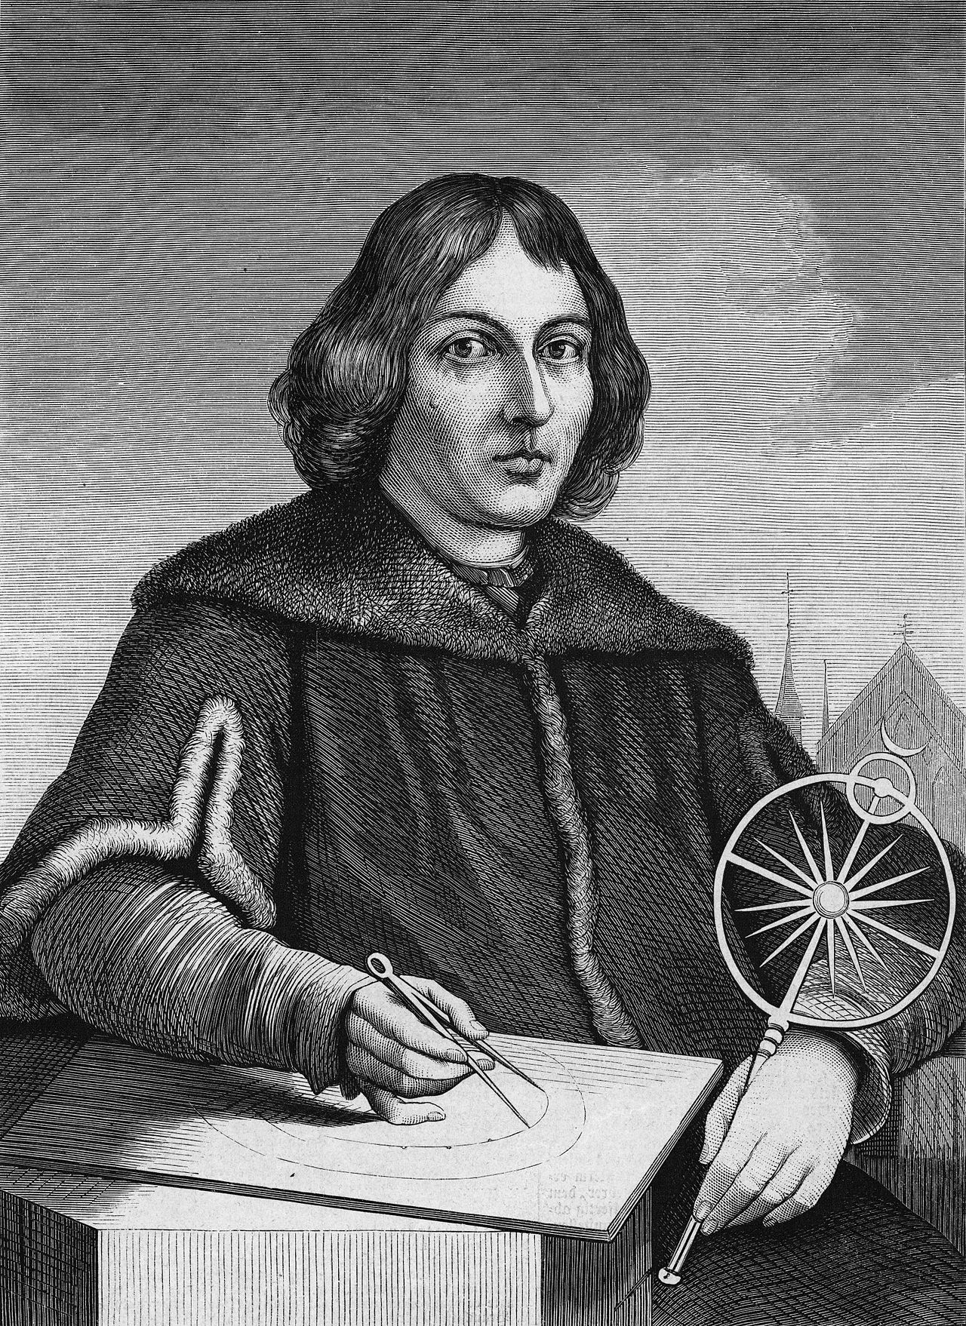
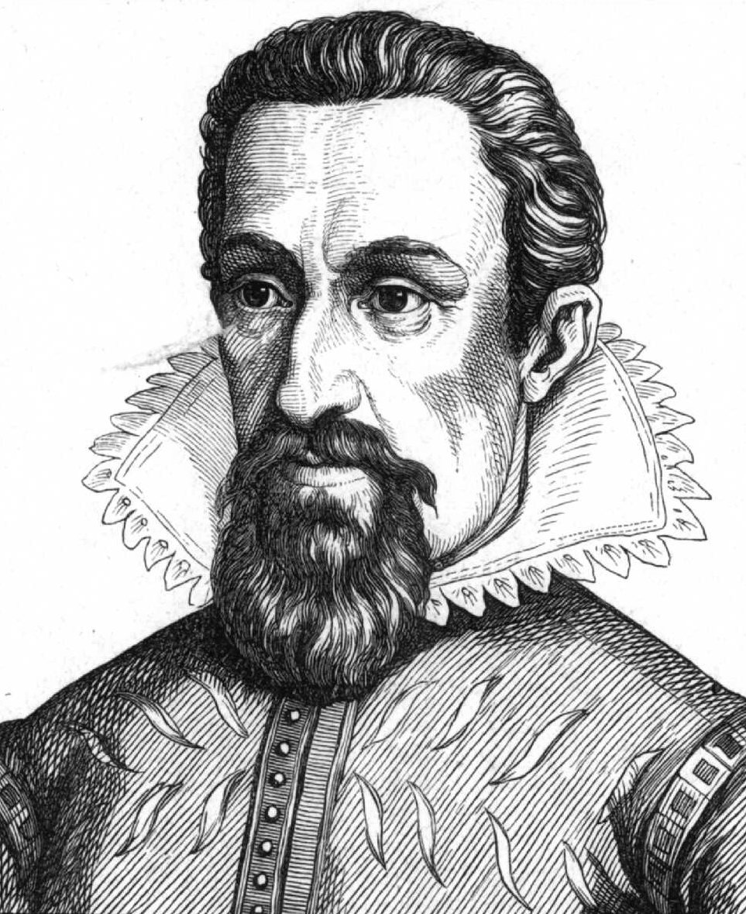
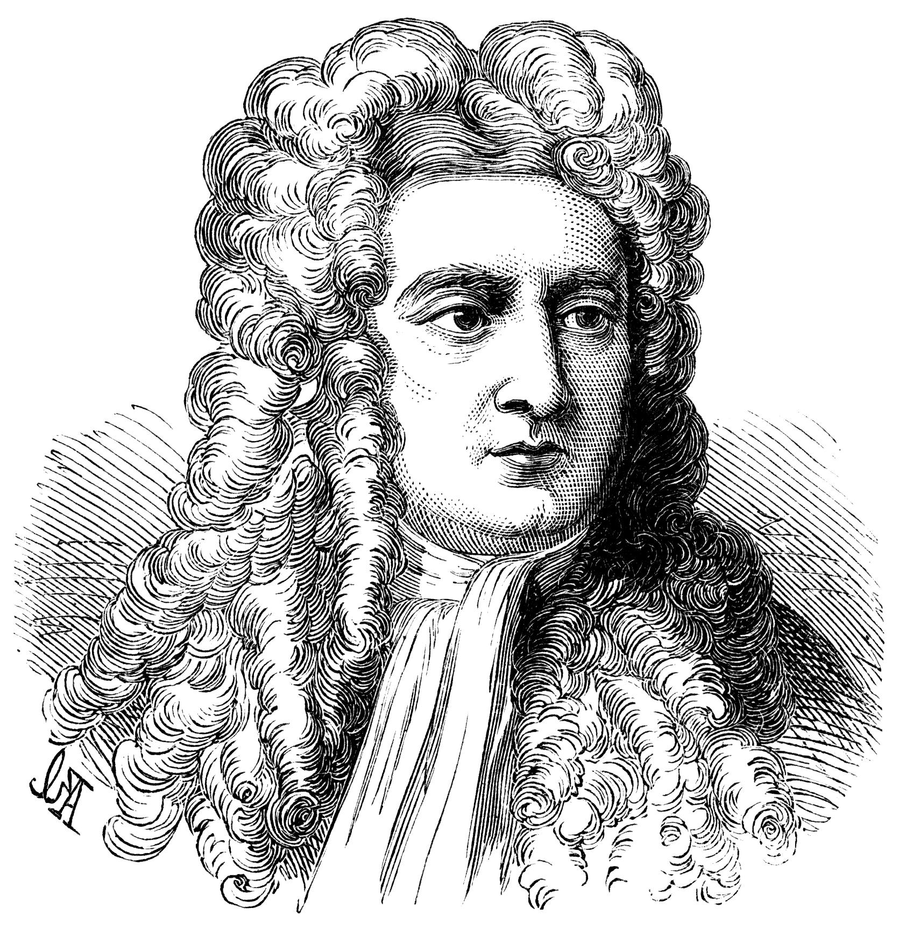
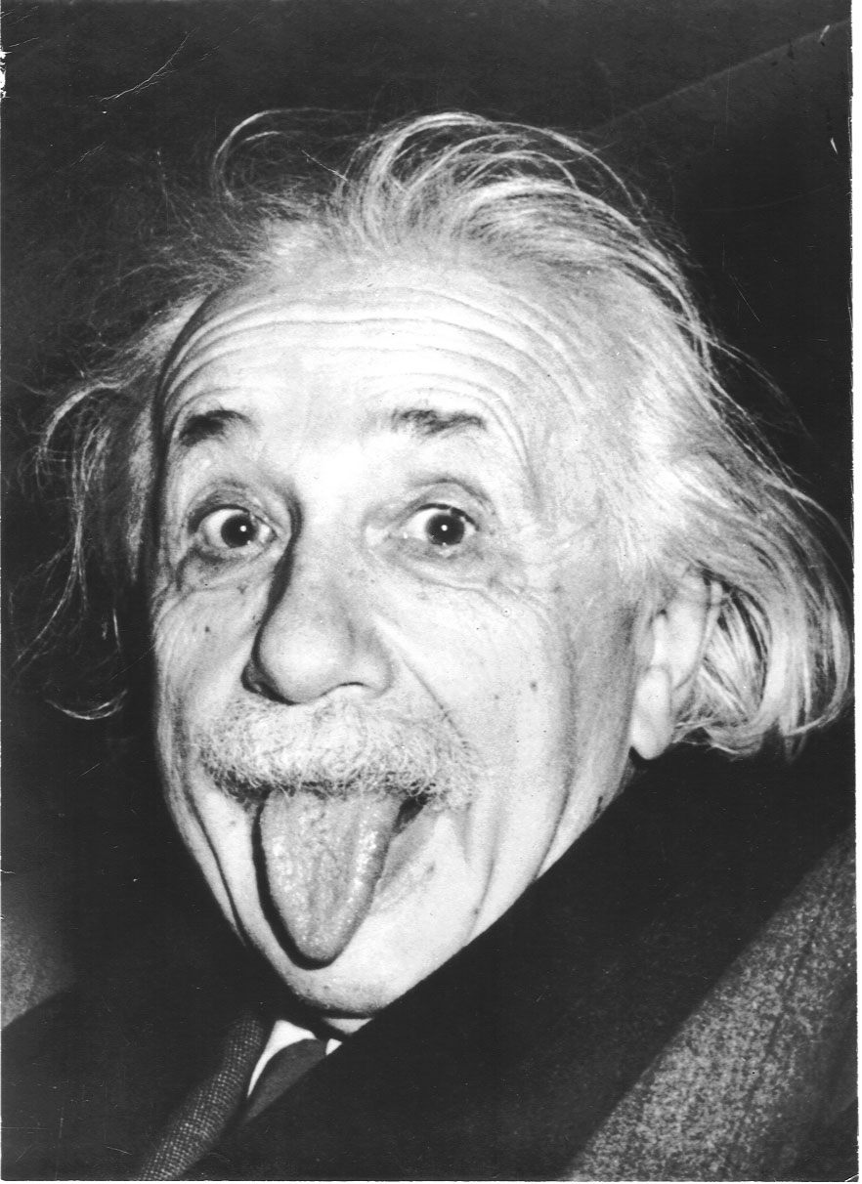
Some History
Geocentric Model
Heliocentric Model
Laws of Motion
Gravity
Relativity
Time

Slide 9
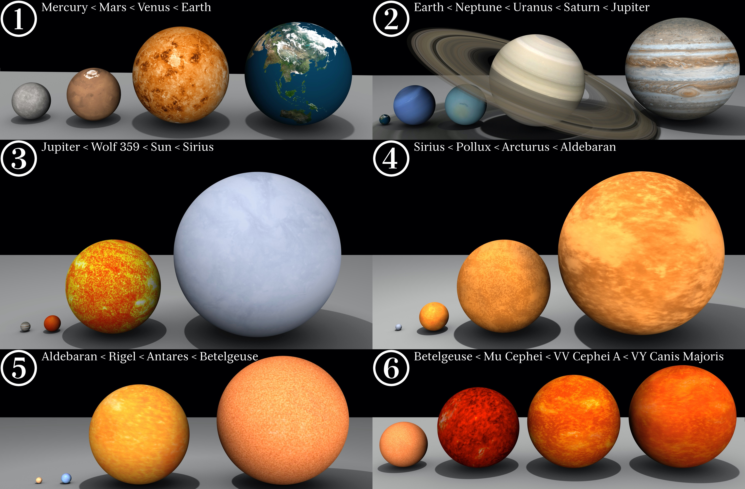
Natural Labs?

Slide 10
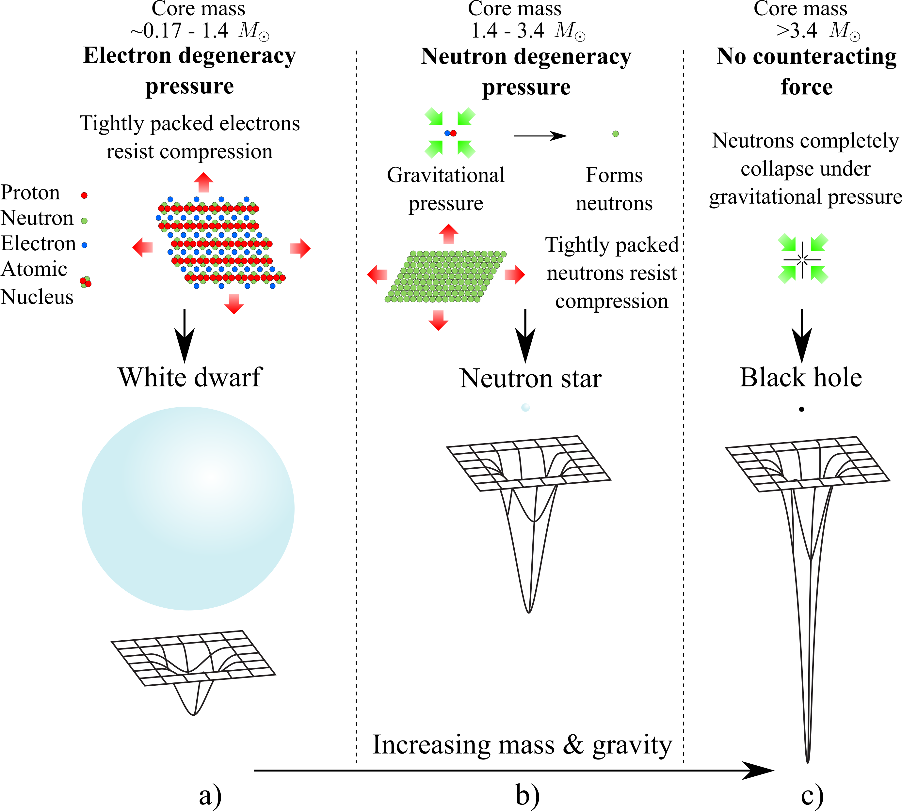
Natural Labs?

Slide 11
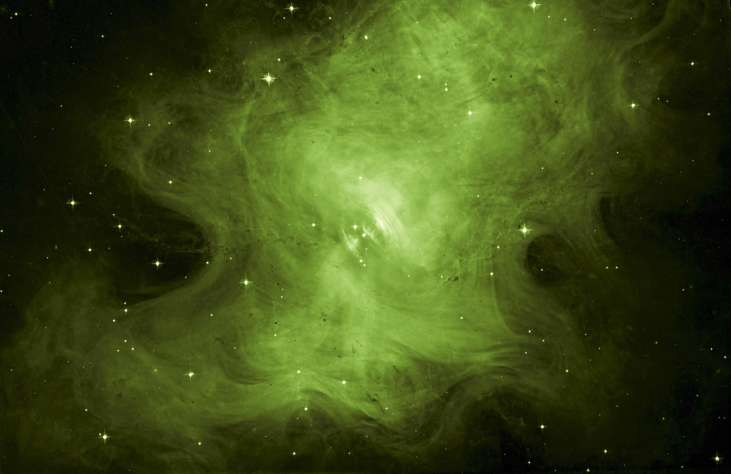
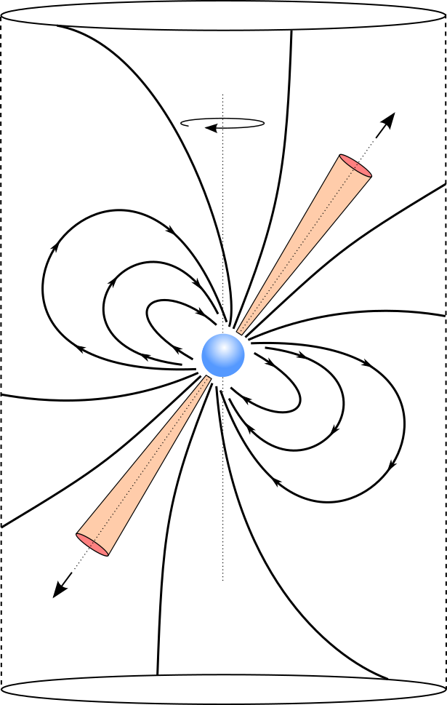
Rotation
Axis
Magnetic Axis
Radio Pulsars
Closed
field lines
Light
Cylinder
Stellar remnant
Very dense
~20 km diameter
Produce radio emission
Very useful for science
Open field line
Radiation
Beam

Slide 12
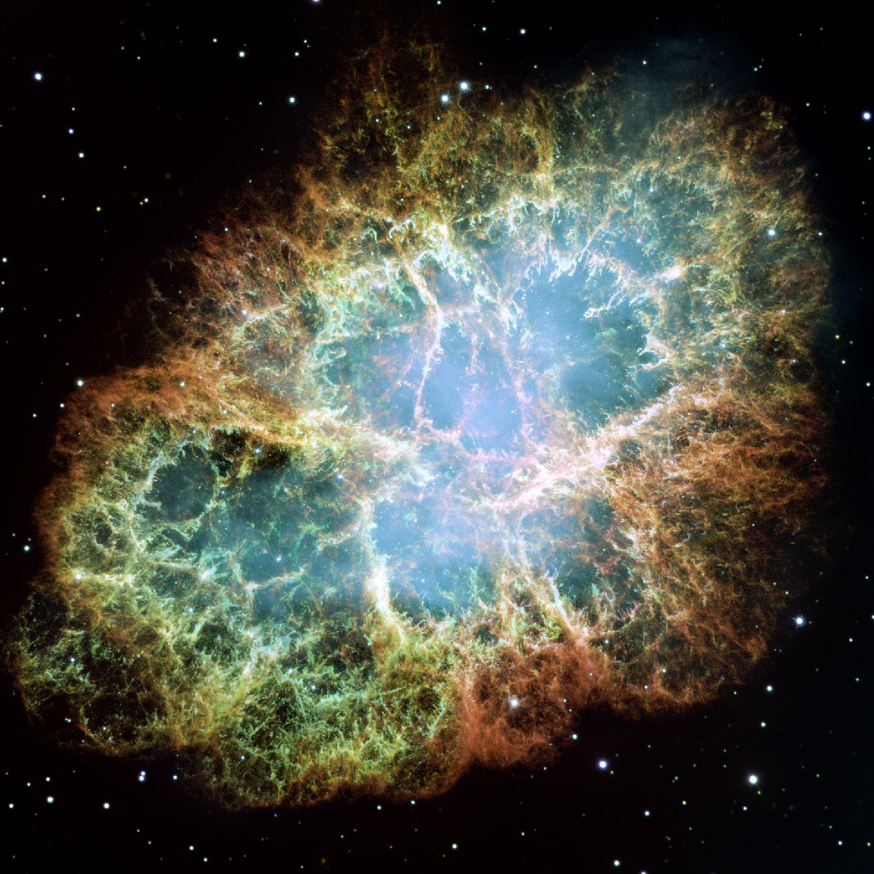
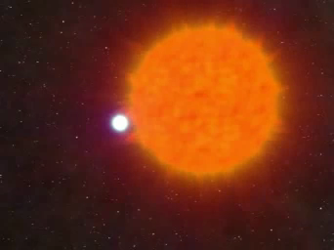
Pulsar Birth
Credit: John Rowe Animations
Notes:
The Crab pulsar has a 33ms period (i.e. rotates 30 times a second).

Slide 13
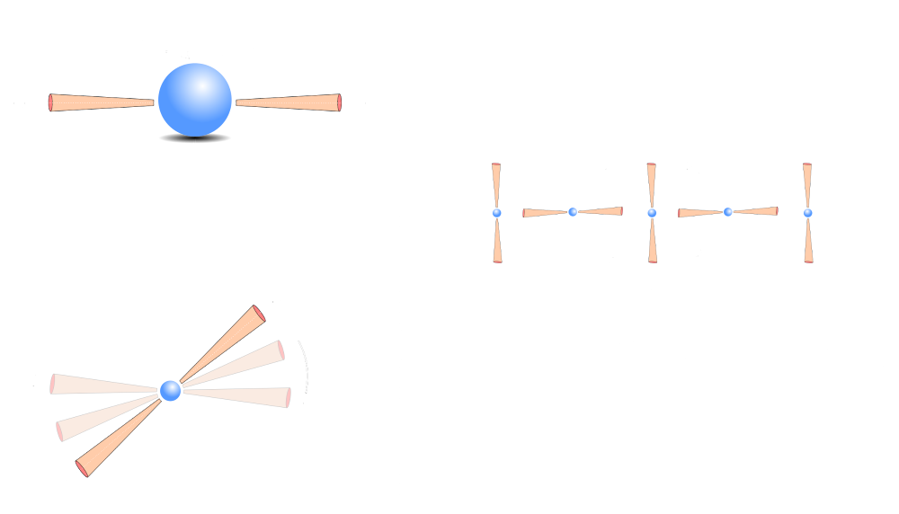
Pulsar Signals
Rotation Axis
Magnetic
Axis
Sweep of
Radiation
beam
Periodic signal
detected on Earth

Slide 14

Pulse Profiles
Complex Pulse Profiles

Slide 15
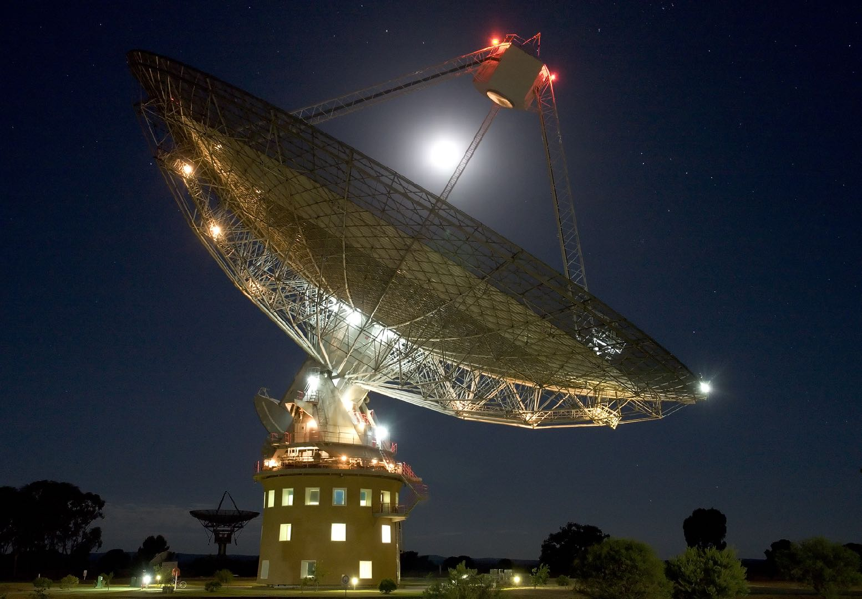







Credit: Shaun Amy
Search Tools

Slide 16
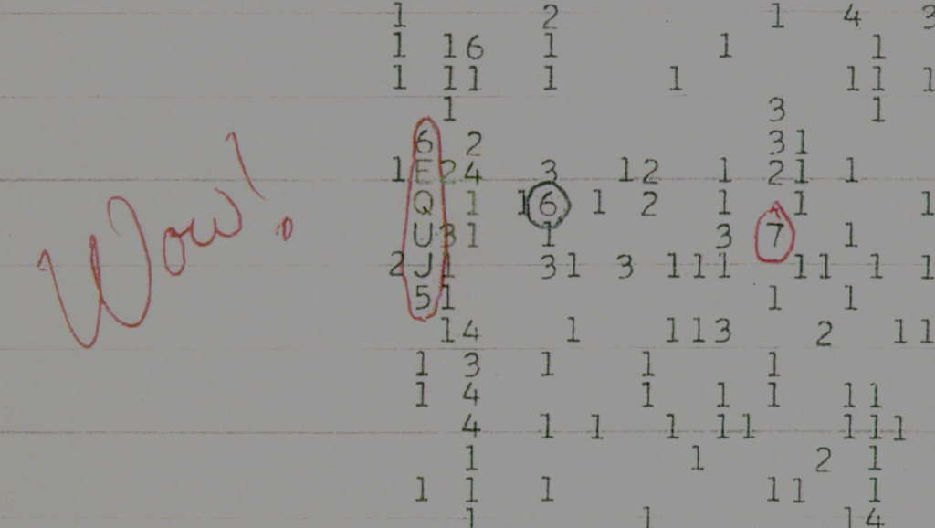
Other Signals
Pulsar Timing
SETI Searches
Studies of Cosmic Magnetism
Studies of stellar evolution
Probing the Interstellar Medium
Radio Imaging
…
Credit: Big Ear Radio Observatory and North American AstroPhysical Observatory (NAAPO).
Notes:
Credit: Big Ear Radio Observatory and North American AstroPhysical Observatory (NAAPO).
Wow signal recorded in 1977, lasted 72 seconds, see at 1420.41 MHz (~hydrogen line), narrowband 10 kHz emission.

Slide 17

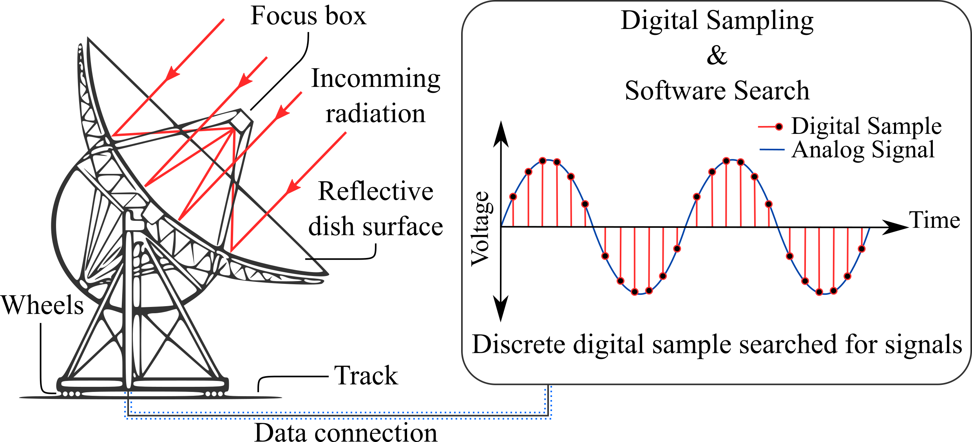
Data Capture
Analog to digital samples
Complex search pipeline applied
Steps:
RFI mitigation
Dedispersion
FFT
Harmonic summing
Detection
Sifting

Slide 18

Data Products
A candidate file
Describes a signal detection
Covers time and frequency space
At least one per detection (duplicates!)
Classification appears simple - things do get fuzzy!

Slide 19
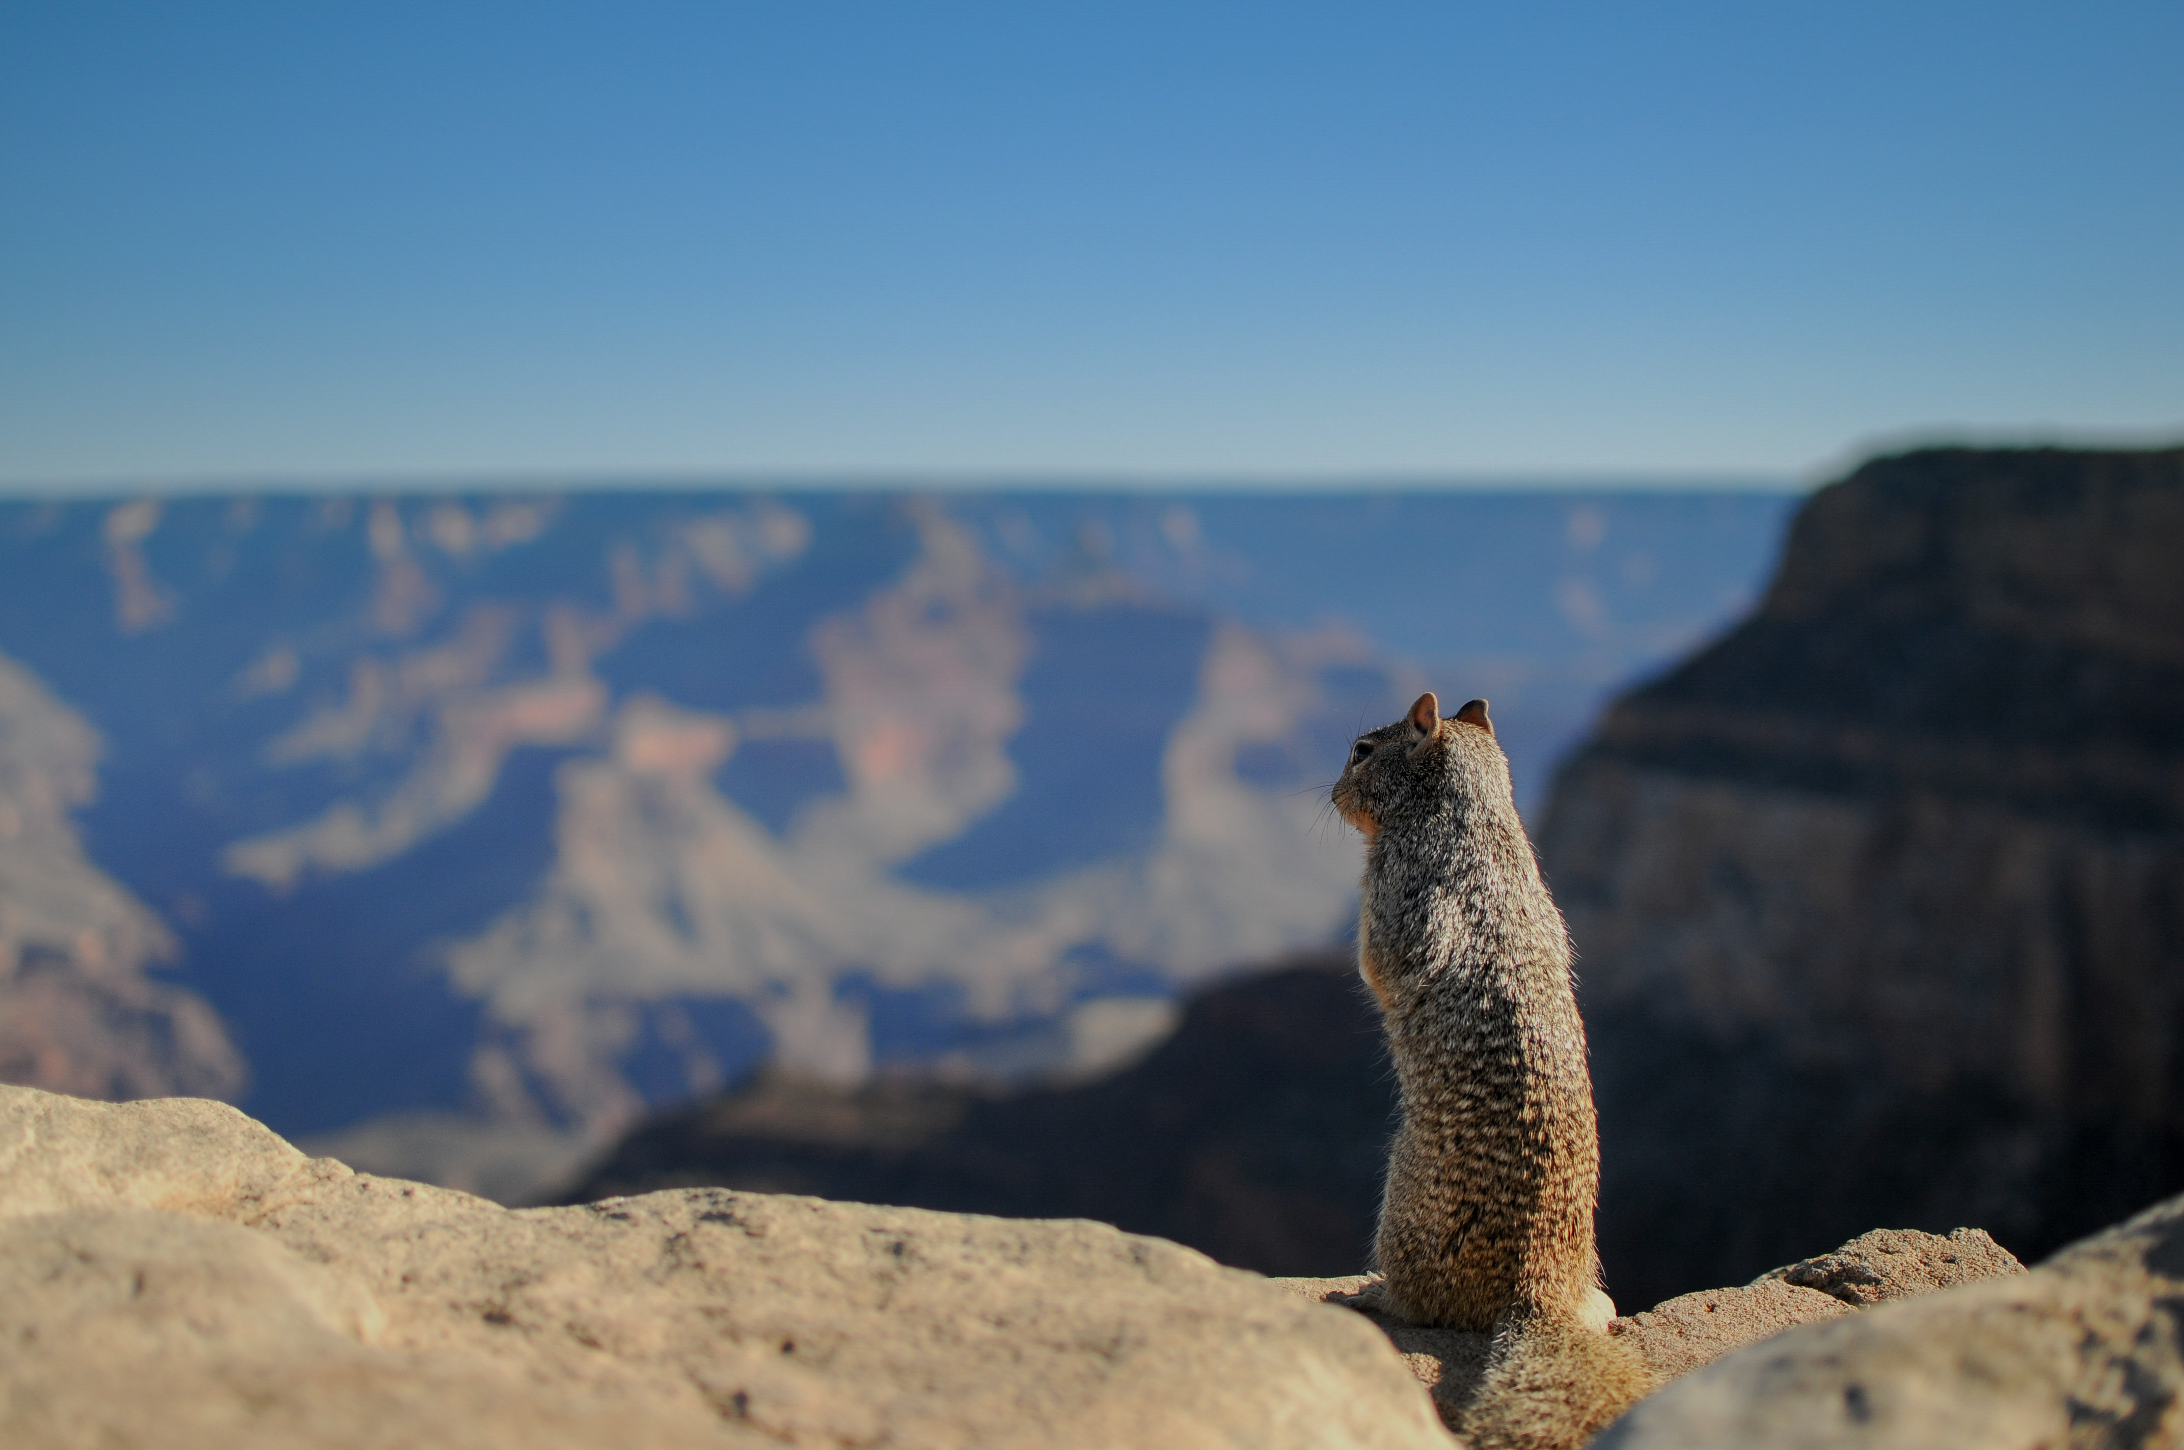
What to look for?
Clear pulse with a defined peak.
Evidence that the signal persists in time, i.e. an indication of a periodic source.
Evidence that the signal persists in frequency - pulsars are broadband emitters.
A DM value greater than zero.
Evidence of other effects, such as scintillation?

Slide 20
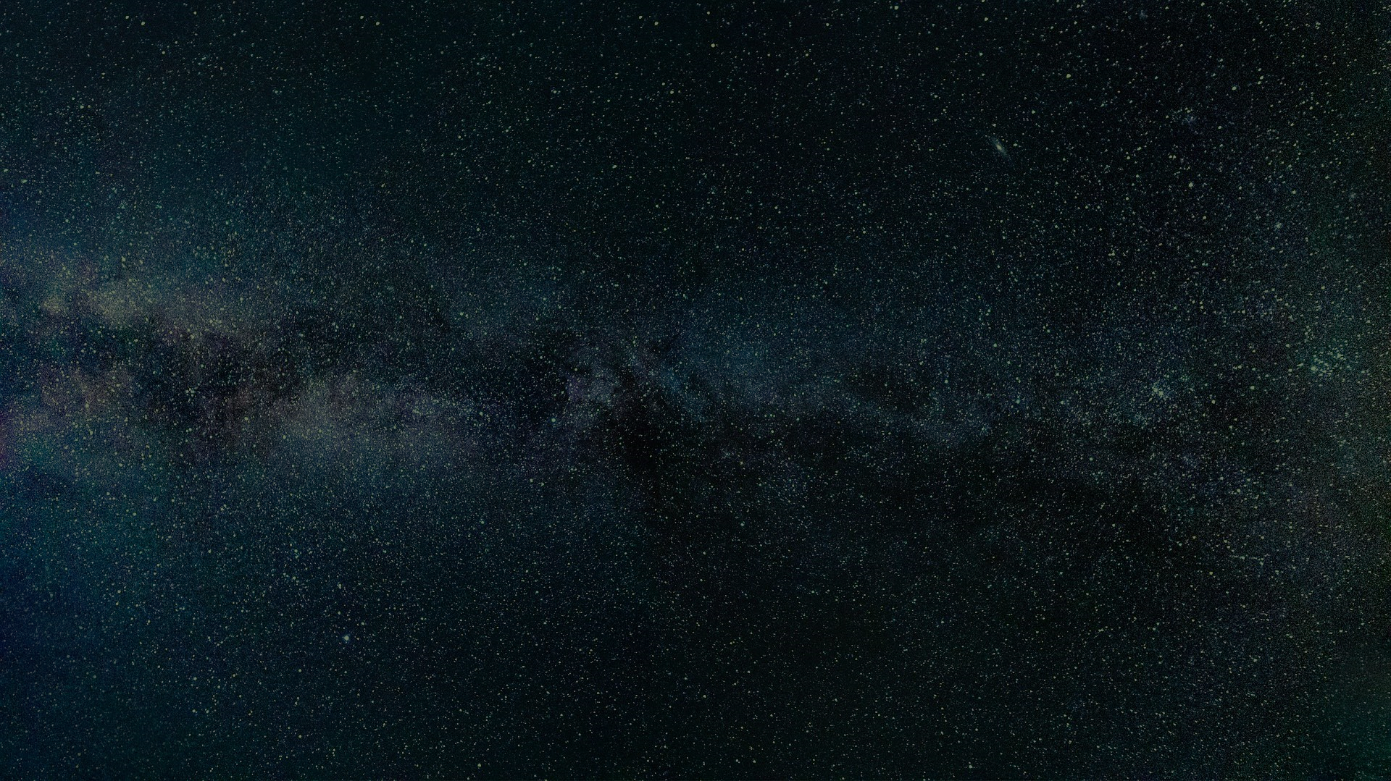
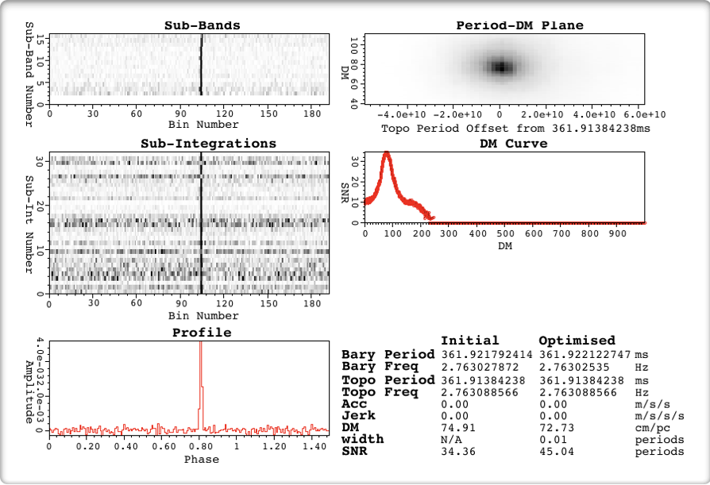
Candidate Examples (1)
Defined peak
Clear DM-SNR peak
Consistent in time
Persistent in frequency
Obvious pulsar!
Credit: HTRU Collaboration.

Slide 21
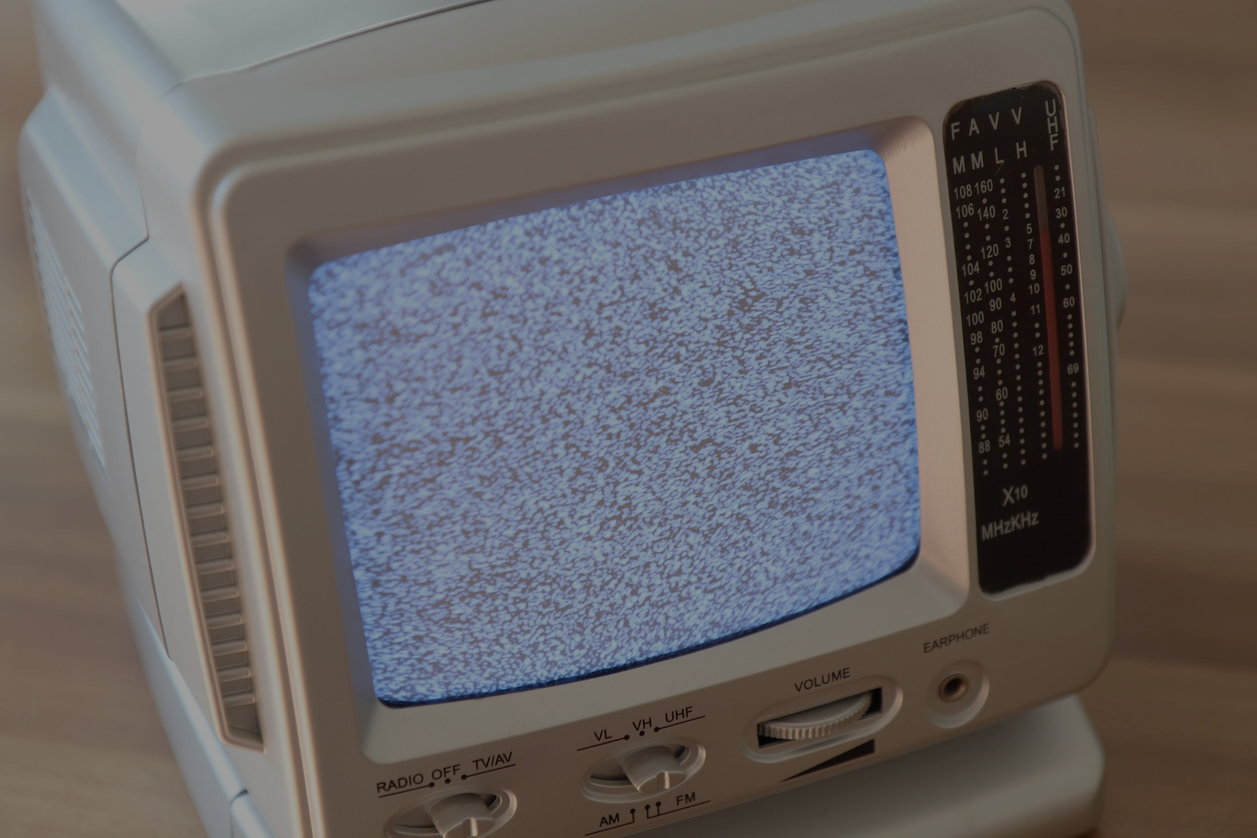
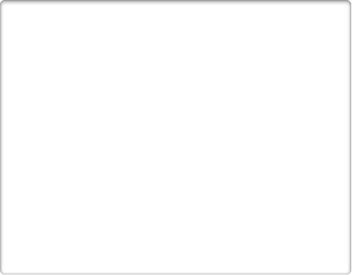
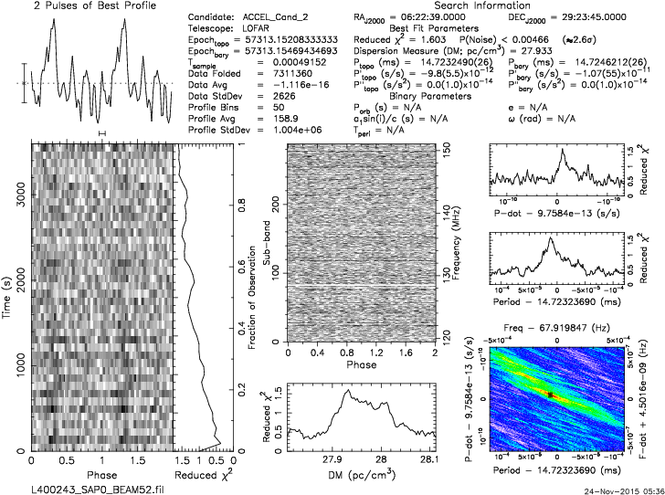
Candidate Examples (2)
Clearly defined peak?
Some persistence in time?
A DM value > zero
Labelled as noise
Credit: LOTAAS Collaboration (Chia Min Tan et. al.).

Slide 22

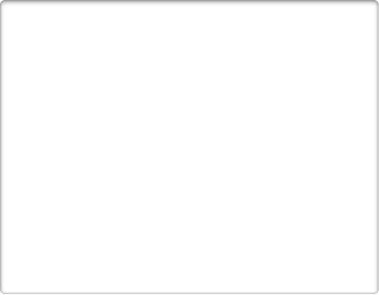
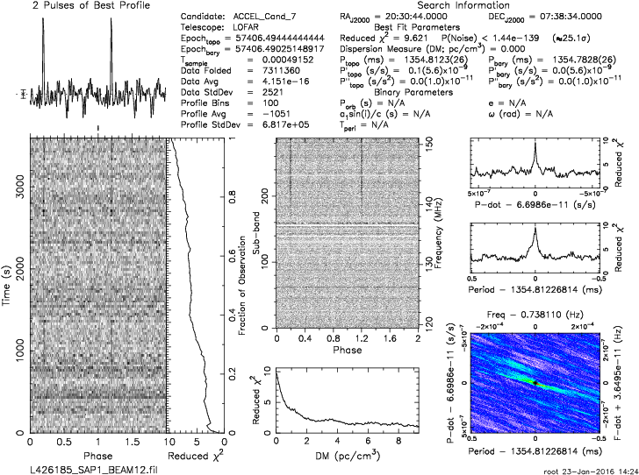
Candidate Examples (3)
Clearly defined peak?
Some persistence in time?
Some persistence in frequency?
RFI
Credit: LOTAAS Collaboration (Chia Min Tan et. al.).

Slide 23
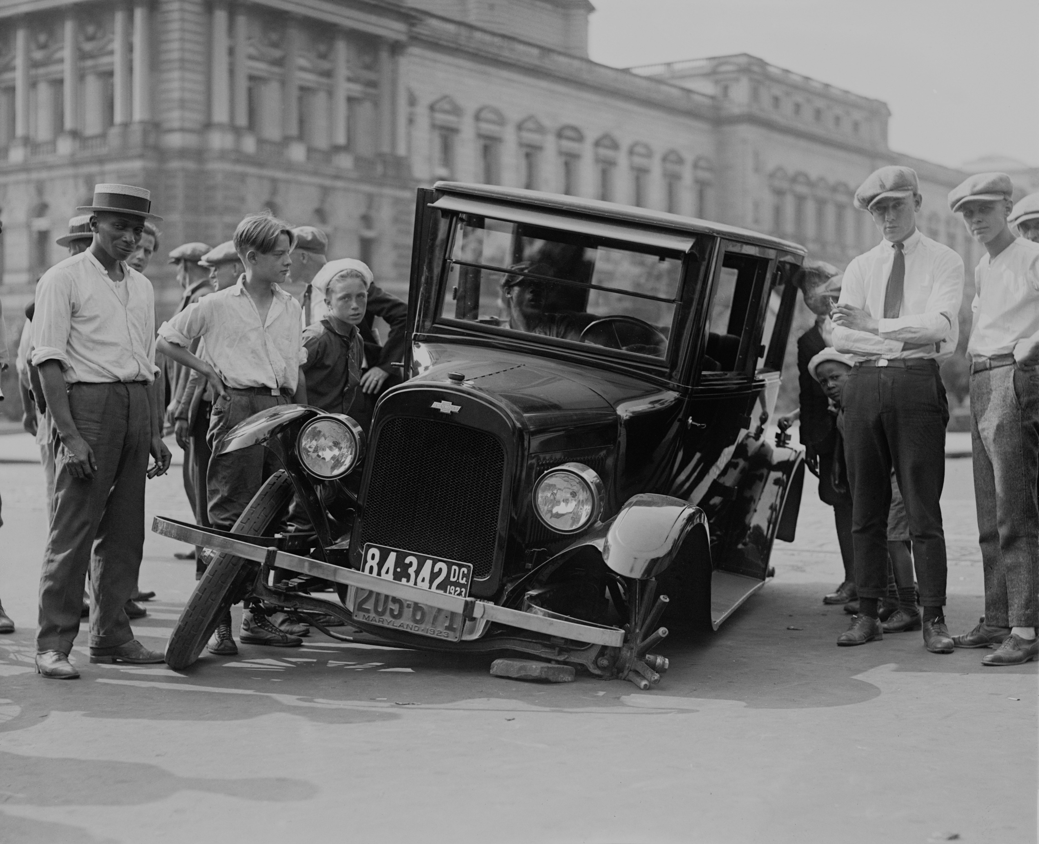
Things go wrong in practice
Not all candidates so easily categorised.
Huge volume of candidates usually returned by telescopes.
This makes the problem particularly hard to solve.

Slide 24

Imbalanced Data too!
Candidate ratio is 1 real pulsar to 10,000 non-pulsar examples (not a worse case).
Given that class distributions drift over time, we have a changing problem too.

Slide 25
Tackling this with A.I.

Slide 26
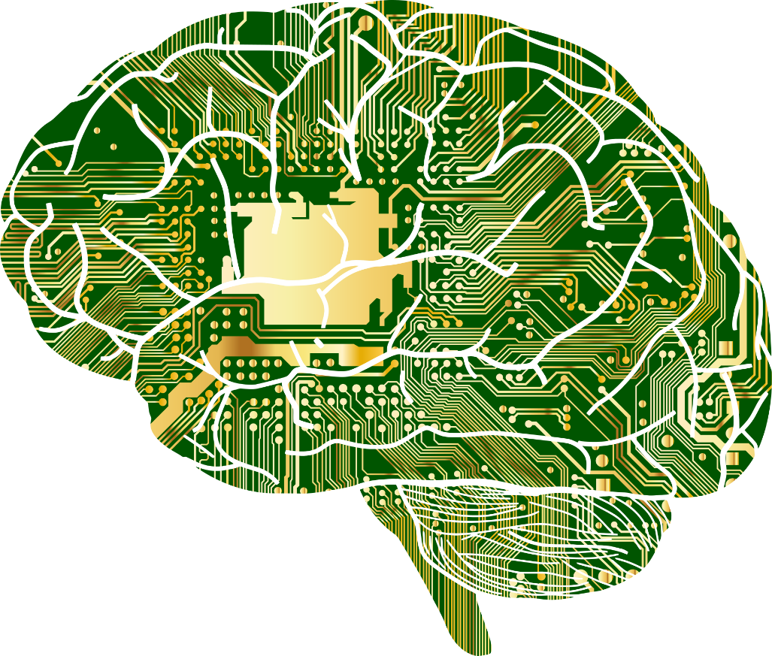
Artificial Intelligence
Artificial Intelligence (A.I.) is a field of study concerned with reproducing/replicating human intelligence.
A.I. is an umbrella term – it is comprised of many sub-fields of study.
Here we’ll talk about replicating the human capacity for learning.
This field is known more generally as “Machine Learning”.
Talking
Consciousness
Seeing
Moving
Listening
Understanding
Language
Reasoning
Learning
Notes:
We hear a great deal about artificial intelligence these days. These a great deal of hype, and we often find exaggerations of what such technologies can do at present in the media. But what exactly is Artificial Intelligence (A. I.). Well, it is a field of study concerned with reproducing, or replicating as closely as possible, human intelligence.
A.I. is actually an umbrella term – it is comprised of many sub-fields of study. These focus upon replicating,
Our capacity for speech.
Our ability to see. Humans have a complex visual cortex that provides us with exceptional vision. Despite this complexity, we are able to process visual information with ease, which is remarkable.
Our ability to process complex auditory information.
Our innate reasoning abilities, that is, our capacity to infer and deduce knowledge from available information.
Our ability to learn from information provided to us, to make decisions.
Our natural ability to interpret language, whether written, spoken, or understood via touch (braille).
Our ability to move our sophisticated bodies around with precision, lift objects, exert fine motor control.
Our consciousness. This is somewhat contentious as it is difficult to define consciousness. Nonetheless, some are trying to replicate this in machines.
Here we’ll talk about replicating the human capacity for learning.
This field is known more generally as “Machine Learning”.

Slide 27
Machine Learning
Machine learning (ML) is a fascinating field. It combines insights from statistics, logic, psychology and neuroscience to build automated systems capable of “learning” by themselves.
ML isn’t concerned with replicating exactly how humans learn, after all, we’re flawed!
Instead it focuses on developing ways to make optimal decisions/predictions using available information.
During this module you’ll acquire an understanding of ML that will allow you to apply it moving forward.
Learning
Notes:
Here we focus on replicating our capacity for learning. This means we’ll be introducing a field of study known more generally as Machine Learning (M.L.). Machine Learning is a fascinating subject. It combines insights from Statistics, Logic, Psychology and even Neuroscience. These are brought together to create automated systems capable of ”learning” by themselves.
Machine Learning isn’t concerned with replicating exactly how humans learn. This is because our learning capabilities are subject to some problems, bias for instance. This makes human decision making flawed. There are countless examples of human decision making leading to bad outcomes.
Thus M.L. attempts to replicate the best aspects of human learning, improving upon them to yield better decision making. To do this machine learning focuses on using available information to make optimal decisions/predictions. What this means in practice will become clear as we progress.
As we progress, you’ll acquire an understanding of M.L. that will allow you to apply it for yourself moving forward.

Slide 28
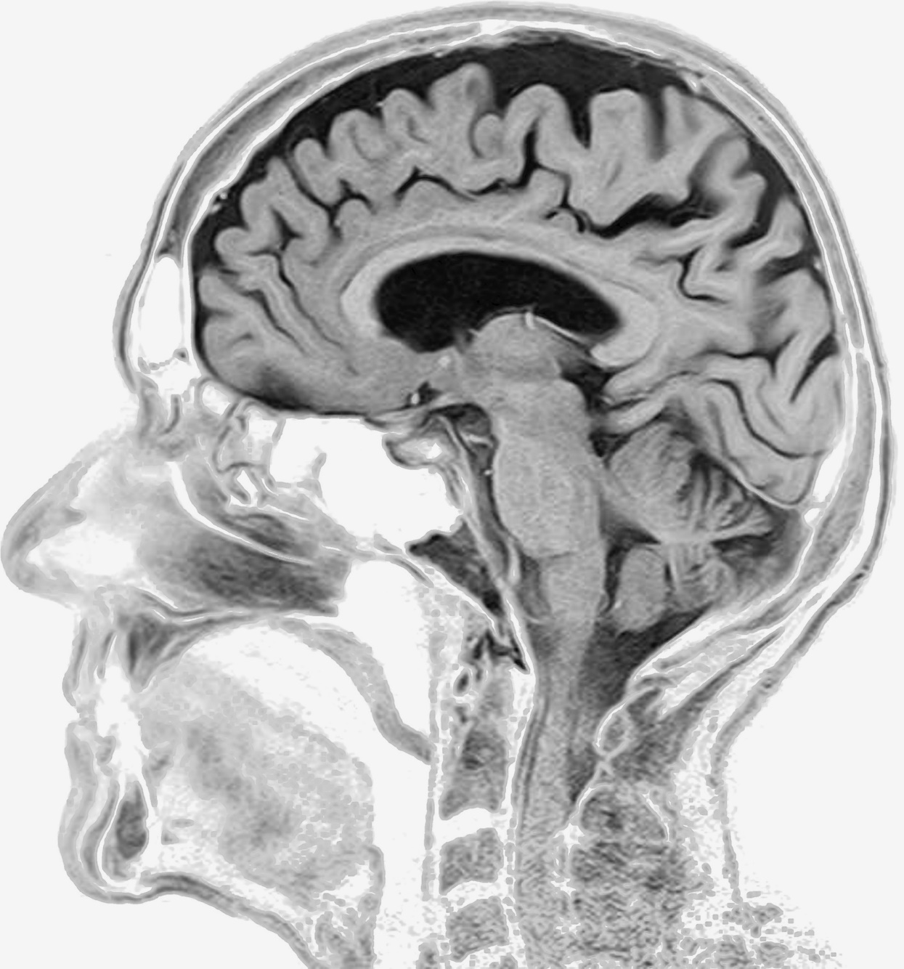
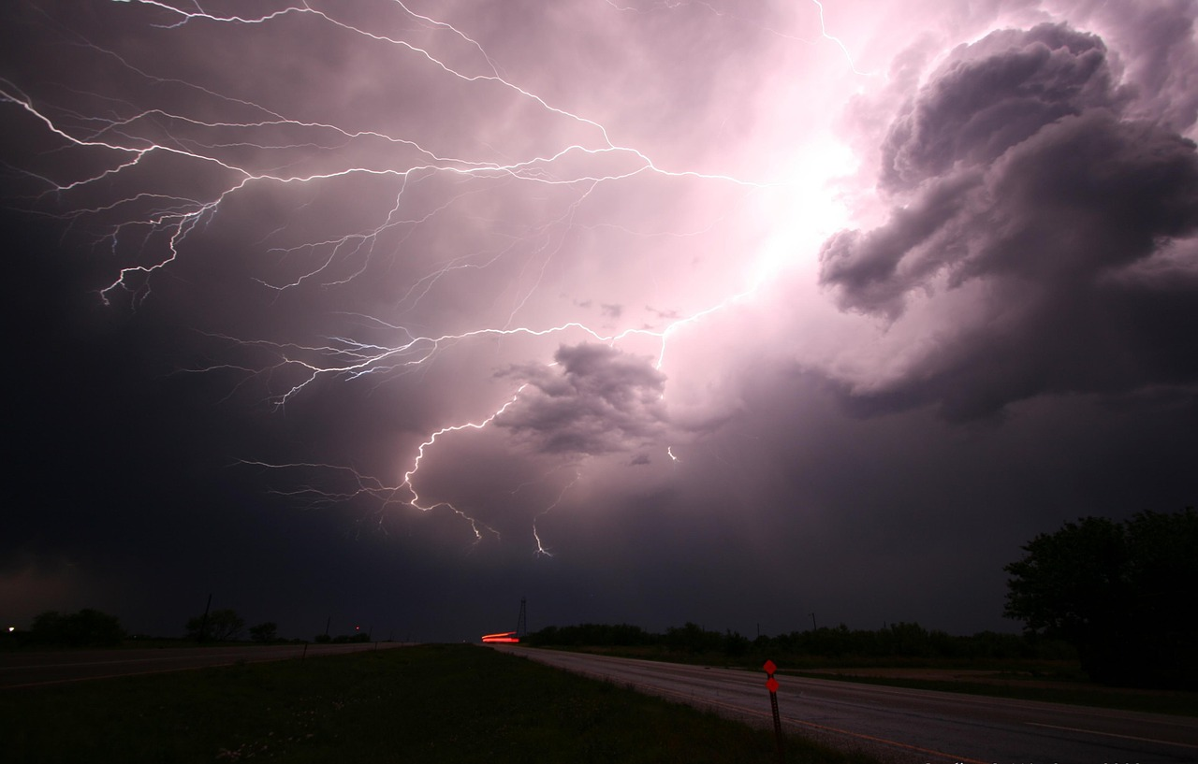
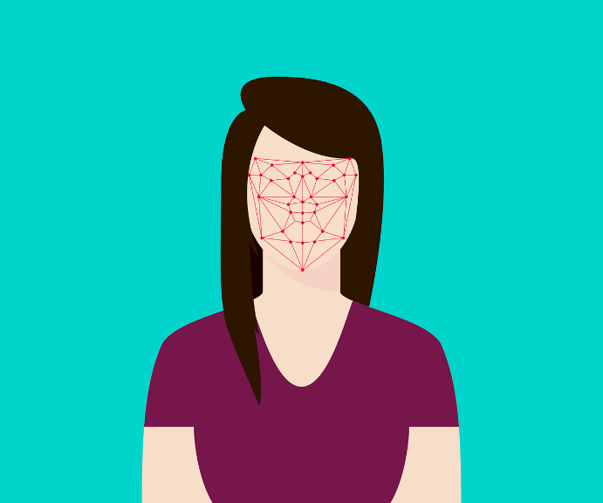

Example Applications
Searching for rare stars in astronomy data
Identifying regions of disease in medical images
Climate Modelling
Image Credit: SARAO
Facial Recognition
Voice Recognition
Uncredited images obtained from https://pixabay.com (Creative Commons License, no attribution required).
Notes:
You may wonder about the types of problems you can apply machine learning to. Well, here are some examples:
In my work I apply machine learning algorithms to help look for rare types of star, using large radio telescopes. Here ML algorithms look for patterns in astronomical data that are unusual in some way.
We can use ML to try and predict weather patterns, very important for various industries.
M.L. is now being adopted by medical professionals, who aim to solve a variety of problems. From identifying regions characteristic of disease in medical images, to personalising radiotherapy doses for individual patients.
M.L. is applied to solve various voice recognition tasks. Such systems can help those with physical impairments, but also can make life easier for all of us via use of tools such as Apple’s Siri or Amazon’s Alexa.
M.L. is being widely applied for face recognition tasks. Your perhaps most familiar with the capabilities of Apple Phones, which can be unlocked upon seeing your face without the need for a passcode.
There are many more domains where machine learning is applied. These examples represent only the tip of a very large proverbial iceberg.

Slide 29
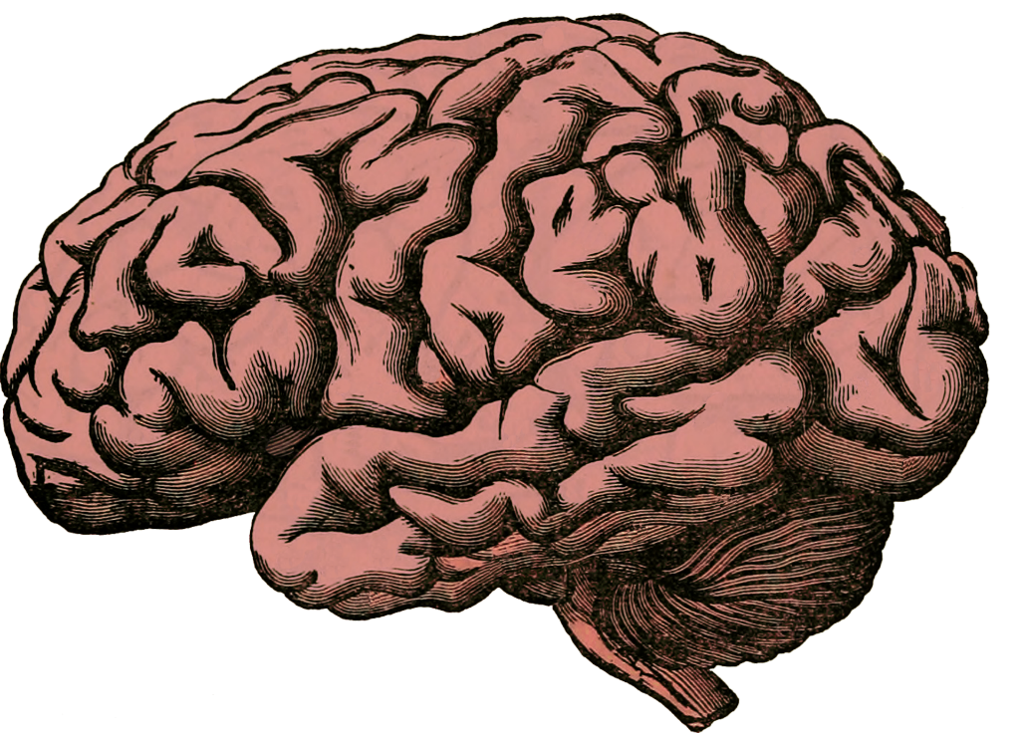
Human Decision Making
Using available information / past experience we try to make optimal decisions.
Actions /Decisions
Data (Sight, sound, taste, touch, smell)
Notes:
Humans are capable of sophisticated learning via trial & error, reinforcement, and by receiving information from some form of “oracle”. An oracle could be a parent, teacher, sibling, friend, book, or an online resource such as this. The oracle provides a source of information that we process, store in memory, and utilize when required. Our memory is capable of storing a lifetime of knowledge and experience, making it a highly sophisticated analogue of a computer hard drive. Though we store information differently to computer hard drives, the content is the same in both cases – data.
This dataset becomes populated as our senses (sight, smell, sound etc.) start collecting information about the world. When we’re born, this dataset is mostly empty. Over time we collect experiences. Eventually we connect our experiences and the information given to us, with some tangible outcome or label.
So, for example, most babies learn automatically that when they cry, then can get parental attention. Ultimately, we learn to use our experiences to make decisions or take actions. Given the same information, it is possible that two people will take very different actions. This is because knowledge and experience differ from person to person. In other words, the content of our memory datasets is different.
Despite any differences between us, human decision making is geared toward making the best, or “optimal” decisions using past experience and available information.

Slide 30
Quantifying Experience
Experience is describable and quantifiable as data.
You already intuitively understand what data is, but to understand ML, we must explain the terminology used in the field.
Variables / Attributes / Features
Ground Truth
Mass (Kg) | Height (cm) | Legs | Colour
4.2 | 25.4 | 4 | Black
18 | 43.5 | 4 | Brown
0.1 | 5.1 | 4 | Grey/Black
… | … | … | …
Class / Label
Cat
Dog
Mouse
…
examples
Table 1. Characteristics of animals we’ve seen
As the ground truth is known, this is called a labelled dataset.
Notes:
Lets continue thinking about experience. Experience is describable and quantifiable as data.
You already intuitively understand what data is. However to understand M.L., we must first become familiar with the terminology used in the field. Lets start by considering that data can be quantified and recorded using a simple table structure.
Here we have a table describing the characteristics of animals we’ve observed at some time during our lives. The animals are described using four characteristics – their mass in Kilograms (Kg), their height in centimetres (cm), the number of legs they possess, and their primary colour when viewed by eye. Each of these characteristics is represented as a column in the table. We can see there are three rows in the table, representing three unique animals.
In machine learning we refer to the characteristics – mass, height, number of legs, and colour, as features. Sometimes these are also known as variables or attributes, but we’ll stick with the term features.
Each row in the table is called an example. That is, the first row represents our first example animal and so on.
Each example may be associated with a “label”. In this case the label would correspond to the name of the animal. The label is also sometimes known as the “class label”. For instance the first row of the table represents an animal that belongs to the class “Cat”. This class is distinct from all other classes. How a class label is defined impacts it’s interpretation. Thus since we do not clarify here, the label “cat” applies to all species of Feline. But this class label can be broken down into to “sub-classes” such as “Domestic Cat”, “Leopard”, “Panther” etc.
When the labels for examples are known, we say we have the “ground truth” labels. This means the truth is known for certain – i.e. the label is undeniably correct.
When a dataset is accompanied by ground truth labels, we call this data set “labelled”.

Slide 31
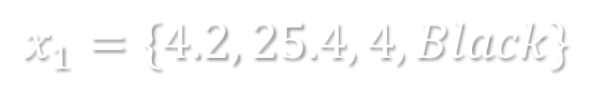
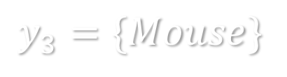
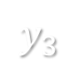
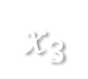
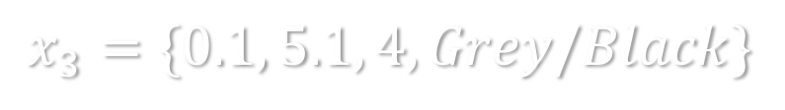
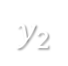
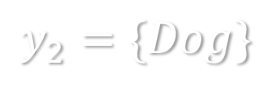
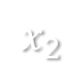
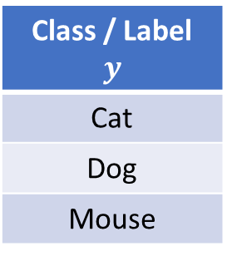
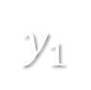
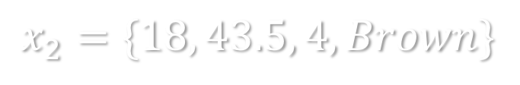
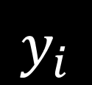

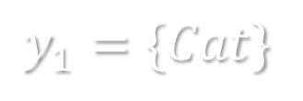

Quantifying Experience
Mass (Kg) | Height (cm) | Legs | Colour
4.2 | 25.4 | 4 | Black
18 | 43.5 | 4 | Brown
0.1 | 5.1 | 4 | Grey/Black
Class / Label $$y$$
Cat
Dog
Mouse
Example
notation
Example
notation
$$x_{1}$$
$$y_{1}$$
$$x_{i}$$
$$y_{i}$$
$$x_{2}$$
$$y_{2}$$
$$x_{3}$$
$$y_{3}$$
Table 1. Characteristics of animals we’ve seen
Variables / Attributes / Features
Ground Truth
$$x_{1}=\{4.2, 25.4, 4, Black\}$$
$$y_{1}=\{Cat\}$$
Array
$$x_{2}=\{18, 43.5, 4, Brown\}$$
$$y_{2}=\{Dog\}$$
$$x_{3}=\{0.1, 5.1, 4, Grey/Black\}$$
$$y_{3}=\{Mouse\}$$
Notes:
Here we can see the same table as before, describing the animals we’ve observed at some time in our lives. Consider the equivalent table you hold in your mind – it will have an enormous number of rows, and many features. To make such datasets easier to study, we label each row using some simple notation.
Here we represent examples using the notation $x_{i}$. At first this may appear confusing – what do $x$ and $i$ mean?
Read $x$ as meaning “example”, and $i$ as a number that uniquely identifies the example. So here we can see there are three examples described using this notation. Now when I say $x_{2}$ you know which animal I’m referring to – the animal in the second row of the table.
We can also represent the class label in a similar way. Read $y$ as meaning “label”, and $i$ as a number that uniquely identifies the label.
So here we can see there are three labels described using this notation. Now when I say $y_{3}$ you know which animal I’m referring to – the mouse in the third row of the table.
This notation allows us to describe examples in a new way, using mathematics that’s easier to write down than written language. Here we represent example 1 as the row values stored between two brackets, and separated by commas. We can also represent the label similarly. These brackets enclose what we call sets. Set’s are simply collections of objects. Thus $x_{1}$ is a set containing the characteristics of the animal in row 1, and $y_{1}$is a set containing the labels associated with the same animal.
We can represent entire datasets using this notation.

Slide 32
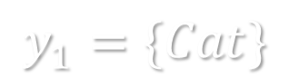
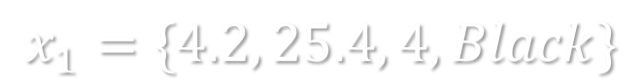




Quantifying Experience
Variables / Attributes / Features
Ground Truth
$$x_{1}=\{4.2, 25.4, 4, Black\}$$
$$y_{1}=\{Cat\}$$
$$x_{2}=\{18, 43.5, 4, Brown\}$$
$$y_{2}=\{Dog\}$$
$$x_{3}=\{0.1, 5.1, 4, Grey/Black\}$$
$$y_{3}=\{Mouse\}$$
$$E=\{\left(x_{1},y_{1}\right),\left(x_{2 }, y_{1}\right), …, (x_{n}, y_{1})\}$$
Experience is comprised of pairs of feature values and ground truth labels.
The pairs are actually called “tuples”.
Notes:
We now understand how data can be represented using some basic mathematical notation. Using this notation we can express what we mean by “experience” in a straightforward way.
Experience is simply a set, $E$, consisting of pairs of features and class labels. In theory it can contain infinitely many pairs, though since our knowledge is imperfect, this is never the case.
These pairs are known more commonly as tuples. A tuple can contain as many features and labels as required. However, for the machine learning we’re discussing here, each tuple contains only one label.

Slide 33









Sometimes Knowledge is Incomplete
Sometimes we don’t know the ground truth. In such cases, we have to collect information, and provide it for ourselves.
This can be costly and time consuming.
Variables / Attributes / Features
Ground Truth
Ext. Temp ($℃$) | Int. Temp ($℃$) | Time (24hr) | Consumption (kWh)
4.2 | 17.1 | 15:23 | 7500
33.4 | 27.8 | 18:01 | 7000
10.8 | 19.1 | 20:36 | 450
… | … | … | …
Class / Label $$y$$
?
?
…
$$x_{1}$$
$$\left(x_{1},?\right)$$
$$x_{2}$$
$$\left(x_{2},?\right)$$
$$x_{3}$$
Deactivated
?
$$\left(x_{3},?\right)$$
$$\left(x_{3},Deactivated\right)$$
Table 2. Status of a heating control system
If the ground truth is unknown, this is called an “unlabelled” dataset.
Datasets may also be “partially-labelled”.
Notes:
Sometimes we don’t know the ground truth. In such cases, we have to collect information, and provide it for ourselves.
This can be costly and time consuming. For instance, suppose we want to learn how to recognise a rare type of disease in medical data. To do this we’ll need labelled examples showing us what disease looks like. We’ll also need examples of what disease doesn’t look like. To get this data patients will need to be scanned, and their scans manually labelled by a medical expert as disease or non-disease. Clearly this process costs time and money.
Suppose we’re given the following dataset. It has 4 features, External Temperature ($℃$), Internal Temperature ($℃$), Time, and Power Consumption.
We’re not given labels for this data. This makes the data hard to interpret – it could relate to a variety of scenarios.
We’re then told this data represents the records of a heating control system.
If the ground truth is unknown, this is called an “unlabelled” dataset.
This can be represented using the following notation.
Sometimes some extra information will be provided, which converts an unlabelled data set into a “partially-labelled” dataset.

Slide 34


Feature Values
Features can be categorical or numerical.
Usually we “discretise” categorical features as this makes them easier for many algorithms to work with. This is either done automatically using tools, or manually.
Mass (Kg) | Height (cm) | Legs | Colour
0.229 | 25.4 | 4 | 1
1.0 | 43.5 | 4 | 2
0 | 5.1 | 4 | 4
… | … | … | …
Mass (Kg) | Height (cm) | Legs | Colour
4.2 | 25.4 | 4 | Black
18 | 43.5 | 4 | Brown
0.1 | 5.1 | 4 | Grey/Black
… | … | … | …
Class / Label $$y$$
Cat
Dog
Mouse
…
Mass (Kg) | Height (cm) | Legs | Colour
4.2 | 25.4 | 4 | 1
18 | 43.5 | 4 | 2
0.1 | 5.1 | 4 | 4
… | … | … | …
Class / Label $$y$$
1
2
3
…
Table 1. Characteristics of animals we’ve seen
We may also “normalise” our data from time to time.
Notes:
Features can be categorical or numerical.
The colour feature and the class label are both represented by categorical data types. Here each potential value corresponds to some category. The mass, height and legs features are all numerical.
Usually we “discretise” categorical features, as this makes them easier for many algorithms to work with. This is either done automatically using tools, or manually.
For instance, here the class labels have been changed to numerical values. These values have been chosen to map intuitively to the original categories.
This time the colour feature has been changed so that it is numerical.
We may also “normalise” our data from time to time. Normalization is a technique often applied as part of data preparation for machine learning. The goal of normalization is to change the values of numeric columns in the dataset to a common scale, without distorting differences in the ranges of values. For machine learning, not every dataset requires normalization. It is required only when features have different ranges.
We can apply this process to mass feature.
Here we can see that the mass values now all lie in a range from 0 to 1. It isn’t important right now to understand exactly how this process works. Rather, we want you to know that it happens, and why. For those that are interested, the notes for slide 10 show how the normalised values are computed.

Slide 35



Human Decision Making
Features (Variables)
$x_{i}$ = { Height, Mass, …, Age}
Labels ( Feedback )
$$y_{i}=\{Cat, Dog, …, Bird \}$$
Notes:
As humans we are able to use our senses to extract the key features, we can use to make decisions.
So for instance when we look at an animal, we can almost automatically assess it’s size, mass, age, species, etc. Humans are gifted feature extractors.
We are also able to assign labels with ease, and extremely quickly.

Slide 36
Human Decision Making
Humans capable of accurately,
Clustering
Classifying
Predicting
Made possible via a feedback cycle.
$$E=\{\left(x_{1},y_{1}\right),\left(x_{2 }, y_{1}\right), …, (x_{n}, y_{1})\}$$
Feedback
Notes:
Using our experience set $E$, humans are capable of extremely sophisticated learning. For example:
Humans are capable of accurately,
Clustering. When given a few examples of different types of animal, we are able to group them together in different ways.
Classifying. We are able to classify unseen animals as for example, a mammal or a bird.
We can make predictions based on our past experiences, for example, it’s unlikely to rain when it’s sunny out.
Such sophisticated learning is only possible due to the feedback we receive during our lives. If this feedback is inaccurate, or poor quality, so too will be our decision making. This seems obvious to say, but a good education, which in principle involves receiving high quality feedback, generally makes individuals better decision makers.

Slide 37







Approaches to Learning
Supervised
Learning
Semi-supervised
Learning
Unsupervised
Learning
$$?$$
$$?$$
Mammals
Mammals
$$?$$
$$?$$
Birds
$$E$$
$$E$$
$$E$$
Contains labels for mammals & birds, goal is to correctly group unseen animals into mammal & bird classes.
Contains examples labels for mammals only, goal is to correctly group unseen animals into mammal & bird classes.
Contains no labels. Instead we use the data to self describe class separation.
Labeled data
Partially-Labeled data
Unlabeled data
Notes:
There are many different types of learning that enable us humans to perform these tasks,
Learning via a teacher. This is known as “supervised” learning. It is called supervised learning, because the teacher supervises the student, providing them with valuable feedback. In this example, we’re given some labelled examples of birds and mammals in the experience set $E$. Then we’re asked to correctly assign a set of unknown animals to their correct class group – either mammals or birds. This is a supervised learning task.
Supervised learning is only possible when we have labelled datasets.
It is possible to acquire knowledge from a mix of independent learning and teacher led learning. This is called “semi-supervised” learning. In this example, we’re given some labelled examples of mammals in the experience set $E$. Then we’re asked to correctly assign a set of unknown animals to their correct class group – either mammals or birds. In this instance we don’t know what birds are, but that’s ok. We can use what we know about mammals to separate the animals into two groups accurately.
Semi-supervised learning is possible when we have partially-labelled datasets.
Then there is “unsupervised” learning. Here learning is done via trial and error, without feedback from any oracle. In this example, we’re given animals in the experience set $E$, but there are no labels. Therefore we don’t know what a mammal is, or what a bird is. Nonetheless, we’re again asked to correctly assign a set of unknown animals to their correct class group – either mammals or birds. To solve this problem, we can use the inherent structure of the data, to self separate it into groups. For instance, most mammals are larger than birds. Thus mammals generally have higher mass. This means we can separate on a feature like mass in this instance. However, that feature may not work, if all the unknown mammals are field mice, and all the unknown birds are Ostriches or Emus.
Unsupervised learning is possible when we have unlabeled datasets.
It is often the case that the type of data available to us, dictates the learning that is possible.

Slide 38



Classification
$$?$$
These problems are “binary” classification tasks.
Called binary, as there are two options (mammal or bird).
Such classification tasks are everywhere, and we do them every day.
To complete them we make predictions.
Classification problems in the real-world are usually far more complex, i.e. more than 2 potential classes to predict.
These are known as multi-class problems. Let’s try one.
$$E$$
Mammals
Birds
Notes:
These sorts of problems are “binary” classification tasks.
They are called binary, as there are two potential classification options. In this case mammal or bird.
Such classification tasks are everywhere, and we do them every day. We classify the weather as likely to rain or not, and pick up an umbrella if needed. We Classify the faces of people we see into people we know, and those we don’t.
We complete these tasks effortlessly. Yet to complete them we make predictions almost without conscious thought.
Classification problems in the real-world are usually far more complex than those presented here. For example there may be more than 2 potential classes to predict.
These are known as multi-class problems. Let’s try one.

Slide 39







Example
Feline
Mongoose
$$?$$
Lutrinae
(e.g. Otter)
Viverridae
(e.g Civet)
Canine
Image Credit: Ran Kirlian - Own work, CC BY-SA 4.0, https://commons.wikimedia.org/w/index.php?curid=4164754
Uncredited images obtained from https://pixabay.com (Creative Commons License, no attribution required).
Notes:
Lets test your own decision making. There are five animal families summarized on this slide, using the image of their most famous member. There is the Feline family, in the top left image, Lutrinae family in the middle left image (this family includes animals like the Weasel, Otter, and badger relative). The Canine famile is in the bottom left image, the Mongoose family in the top right image, and finally the Viverridae family (which includes Civets) in the bottom right image.
The question is this:
Can you tell me which family of creatures this animal is most closely related to? This will only work if you haven’t seen it before….
Is it a,
Canine?
Feline?
Lutrinae?
Viverridae?
Mongoose?
I imagine your currently searching your past experience, and looking for features in the image that will tell you what type of animal it is!
Well, this animal is a Fossa. It is a rare animal endemic to Madagascar. It’s most closely related to the Mongoose family, though appears very similar to Felines in most respects. If you answered correctly, then your past experience was sufficient for this task. If not, then your experience was lacking - but now you’ve learned via trial and error, so you’re unlikely to make this mistake again.

Slide 40

Could you generalise?
In the last slide, we saw an animal you may not be familiar with.
Even if you have extensive knowledge of the animal kingdom, you may not have known the animal was a Fossa.
Perhaps this animal was not described in the dataset, .
Even if you did not know it was a Fossa, you could still tell it was a type of mammal.
This application of your knowledge, from past experience, illustrates your ability to generalise beyond known facts.
Humans are gifted generalisers - but they are susceptible to two problems:
$$E$$
Overfitting
Underfitting
Notes:
In the last slide, we saw an animal you may not be familiar with.
Even if you have extensive knowledge of the animal kingdom, you may not have known the animal was a Fossa.
Perhaps this animal was not described in your personal experience dataset.
Even if you did not know it was a Fossa, you could still tell it was a type of mammal.
This application of your knowledge, from past experience, illustrates your ability to generalise beyond known facts.
Humans are gifted generalisers - but they are susceptible to two problems:
Overfitting. Overfitting occurs when we learn so well that our knowledge becomes too specialised. Imagine there’s a student trying to prepare for an exam. They buy a revision book and learn every factoid it contains. The student fails to realise that the book doesn’t contain all the knowledge that could be tested in the exam. They take the exam, and the worst happens – nothing from the revision book is in the exam. In this case, failure happens because the student over trained, that is “overfitted”, to the revision book.
Underfitting. Underfitting occurs when our knowledge becomes too flimsy. The student who failed before now tries to resit the exam. This time, they buy 100 revision books to learn from to avoid their last mistake. Except they can’t process that much information. They diligently dip into each book lightly, not covering any topic to any great depth. The student takes the resit and the worst happens again – their knowledge is too shallow and they fail the exam. In this case, failure happens because the student under trained, that is “underfitted”, to the revision books.
It is desirable to achieve a balance between under and over fitting in practice. There is certainly a trade-off to be had.

Slide 41
Making Optimal Decisions
Many have tried to understand how to make optimal decisions.
We know we should use available evidence at all times.
Humans are not always so thorough - we do make bad decisions.
We are biased decision makers - we often use instinct and personal experience to decide.
Available
Knowledge &
Experience
Personal
Knowledge &
Experience
2
3
$$E$$
4
Knowledge used
to make a decision
Set of all knowledge
on a subject
1
Notes:
Many have tried to understand how to make optimal decisions.
We know we should use available evidence at all times.
Humans are not always so thorough - we do make bad decisions.
We are biased decision makers - we often use instinct and personal experience to decide.
We can visualise our knowledge and experience which helps us understand decision making more clearly. Suppose the blue box labelled 1, represents the set of all knowledge of some subject. This idealised set that contains every piece on information available which may be stored in books, web resources or in the minds of other people.
The circle labelled 2, represents the portion of that knowledge that is available to us. It is an incomplete portion, thus it is a subset of the knowledge available. It is incomplete for many reasons. For instance, our local library doesn’t contain every book ever written on a subject. Nor do we have access to the knowledge of scientists working at the forefront of research. So we already have a gap in our knowledge at this step.
Then there is the personal knowledge and experience of the subject that we already possess. This is represented by the circle labelled 3. This is a subset of the knowledge available to us. This will vary from person to person. For example if the subject is planet formation, those with PhDs in Astronomy will have greater knowledge than those without such a background.
Finally there is the knowledge we ultimately use to make a decision. This is represented by the circle labelled 4. This is a subset of the knowledge we possess. For example, when trying to classify unknown animals as either birds or mammals, we don’t need to use our knowledge of insects.
Here we’ve talked about knowledge, but not the mechanism via which it is used to make decisions. In humans that cognitive function is sophisticated. Emotions and personal bias influence our interpretation of available information, which in turn impacts our decision making.
Let’s consider 1 more example. Over thousands of years the human race has conducted countless scientific experiments showing the Earth is round. We’ve collated mounds of information related to our planet, it’s properties, and it’s place in the solar system. Yet there are groups of people who reject this information due to their personal biases and how they interpret the world around them. They erroneously believe the world is flat. More knowledge will not necessarily change their view – rather their biases and thinking process must change.

